Slide 1


Nyc RAP Site Mentor Information Session
2024

Slide 2
Introduction
The team
The intention of this meeting
The presentation slides will be sent to your email after this webinar
Notes:
Thanks for being here it is good to see faces
We want to start having these info sessions regularly so that our partners understand our needs
And we can support you and the RAs in having a great experience

Slide 3
New RA Request Process/Timeline
Request for Expression of Interest – 12/8/23
    Summer (Early June)
    Fall (Early October)
    https://forms.office.com/g/3H1F3dbJwE
RAP - 34 Weeks
    $625/week Stipend
    $1000/month Housing Allowance
    $2750 Training, Travel Relocation Fund
Review Submissions – 12/11 – 12/15
RA Budgets drafted – 12/11 – 12/22
WPAP Actions Needed – 12/18 – 12/22
WPAP Due – 1/12/24
Finalized G&A SPA – 1/15 – 1/26
Submit G&A SPA Package – 2/4/24
G&A Executed – 5/1/24

Slide 4
Extensions, Modifications, & Intern Requests
PLEASE BE AWARE:
We would also like notification of a MOD or extension 2-4 weeks prior to term end dates, we cannot guarantee successful execution within 2 weeks of expiration or fund depletion.
Only extensions that are 8 weeks or more can be added to an RAs term
Resource Assistant Program** We are moving toward 8-12 month (32 weeks or greater) terms. This allows time for Direct Hire Authority conversion and the FS HR process.
Notes:
All of this reduces stress and creates less chaos
And will ensure you get what you need.

Slide 5
Communicate with NYC immediately:
If a sexual harassment or discrimination situation occurs
If you are injured in the workplace
If a personal emergency arises and you need to take time off
If there is a change in site supervisor
Notes:
It is imperative that NYC be notified of certain situations to collaborate with our partners as the employer of record.
Please be aware that we need to be notified as soon as possible when certain scenarios arise
Such as,
1. If the RA makes or is involved in a sexual harassment or discrimination complaint
we would need to involve our HR Officer as early on as possible.
2. If you experience problems with performance, behavior, or absenteeism
We need to know if there are performance issues so that we can support the RA and mentor appropriately.
We will have to document events, help collaborate for resolution, and support the partner with termination if necessary.
3. If there is a change needed in the length of a term or if a personal emergency arises for the RA that requires time off
Absences or changes to start or end dates may affect stipend and time sheet approval,
4. If there is a change in site supervisor we will need to redirect timesheet and production approval emails to ensure that timesheets and production will be approved on time
so please let us know when these things pop up for you so we can help

Slide 6
Emergency protocols for NYC
Follow USFS emergency procedures
Notify NYC Program Coordinator as soon as possible
For on-going or unresolved emergencies after business hours, please call the NYC emergency phone @ (541) 968-6520
Complete and return Worker's Compensation/Incident Reporting form as appropriate within 24 hours
Important forms and the E phone number are located on the private link given out in onboarding emails, please bookmark this for future use as it is not a public page!
Notes:
First, of course, please follow all your internal emergency protocols,
then
communicate with our dept staff by phone as soon as possible
This will help NYC communicate with family and the public as appropriate in sensitive situations
For emergency communications after business hours, please call the NYC emergency phone number to inform us of an incident.
The Ephone is staffed nights and weekends so someone should be available to you
If you need to complete and submit Worker's Compensation/Incident Reporting forms for injuries, near-misses, or accidents
The form is located on the NYC website in our partner resources pg.

Slide 7
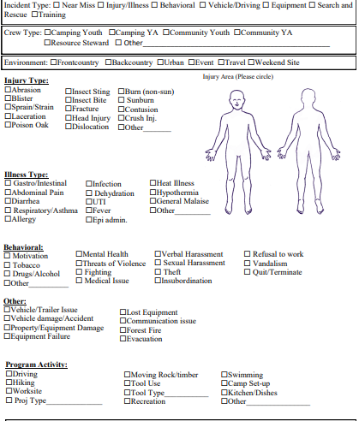
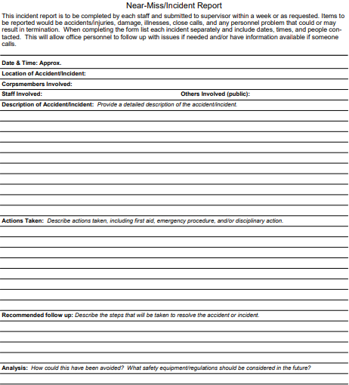
Incident Report
Form
Notes:
Highlight the learning opportunity with these incident forms
Also usable for behavioral incidents/ interpersonal incidents

Slide 8
Attendance Policy Reminders
Average of 40 hours per week
Observe all Federal holidays
Coordinate making up sick days and or days off
PTO - 80 hours of leave/12 months of service are provided
Absences outside of PTO (unpaid) must be approved by your supervisor and NYC must be notified prior to the absence
Unpaid absences will result in a prorated or paused stipend
Notes:
If NYC is not notified prior to the absence, your paycheck will be adjusted for the amount of unpaid days missed in the following pay period.

Slide 9

Remote Work Policy
Due to limitations surrounding worker’s compensation
RAs must live in:
    ID
    OR
    WA
- If you live in one state, but work in another, we recommend talking to a tax specialist if you have questions on withholdings.

Slide 10
Background Checks
The top candidate selected by our partners will undergo a national criminal background check through NYC prior to their hire date
If reports are found, NYC will utilize a hiring matrix to determine continued eligibility for onboarding. Site supervisors will be notified via email regarding reports found and if it is allowable based on our eligibility matrix. If it is an allowable report, we will require your approval prior to onboarding based on the duties of the intern and your internal policies.
Additionally, there is an appeal process for those individuals that may be denied.
If the results have not come back by the anticipated start date, we will have to delay the intern's start until results have been received and approved.
  To avoid this issue, please give minimum 2 business days between candidate selection and anticipated start date.
Notes:
For individual placements and RAP interns (no change for AmeriCorps background check process FYI).
The top candidate selected by our partners in the interview process will undergo a national criminal background check through NYC prior to their hire date
Results will be given to the site supervisor via email for approval,
NYC will not screen for the agency or organization.
Meaning if a they have something pop up in their background check, NYC will not be deciding if they will be hired or not.
This will be up to the partner based on the duties of the intern and your internal policies.
If the results have not come back by the anticipated start date, we will have to delay the intern's start until results have been received and approved by you.
To avoid a start date delay, please allow a minimum of 2 business days between candidate selection and anticipated start date.

Slide 11
Orientation & Exit with NYC
We ask that you please plan for the top of the first & last day of the intern’s term to be available for orientation and exit with NYC, this will typically take around 1 hour. After, they will be released to the site supervisor.
This will help us ensure we have all the needed paperwork for compliance and that the intern will understand expectations from the beginning.
If this is a problem, please let us know! We can work with you for unique circumstances.
** Important note! Please make sure your intern is set up for success with access to a computer and internet connection to participate in orientation and exit and to input their monthly timesheets and production reports for your approval.
I-9 requirements have changed and now require a physical copy of ID documents to be seen on the first day. We appreciate your assistance in helping us stay in compliance.

Slide 12
Timesheets
Timesheets and Production logs need to be signed submitted and approved by the 20th of the month (especially for AmeriCorps!
Time approved by a supervisor is what will be paid, so please be vigilant about time approval and accuracy of hours worked.
Notes:
The changes should only eliminate the need for printing to sign timesheets making approval easier.
We will make sure that interns and supervisors receive necessary training when we make our jump to the new system.
Please stay tuned for those changes anticipated in mid-Spring.

Slide 13
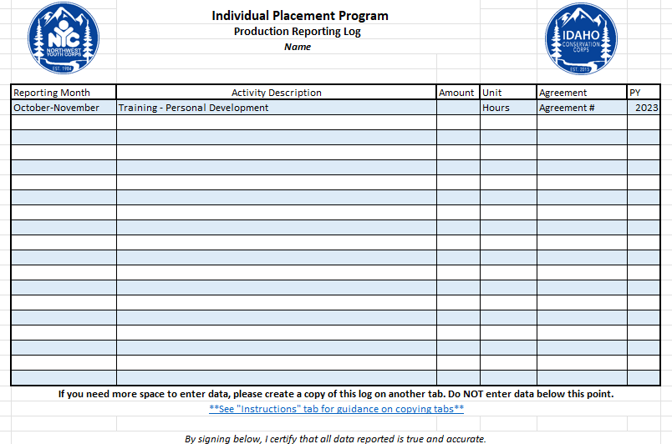
Production Reporting Reminders
3-5 activities per month, approximate
Can upload directly to database OR record in Timesheet Workbook and email monthly
  Monthly Reporting Form (airtable.com)
Notes:
Looking for 3-5 items, approximate report

Slide 14
Reimbursement Policy
Must be pre-approved by supervisor via email
Submit receipts to AirTable link or email directly to coordinator
Must be an itemized receipt
Mileage reimbursement requirements:
Driver Record Check (one time during onboarding)
Must pass a Driver Training Course (one time)
Driver License Upload (with every submission)
Auto Insurance Card/Policy Upload (with every submission)
Mileage Log (with every submission)

Slide 15
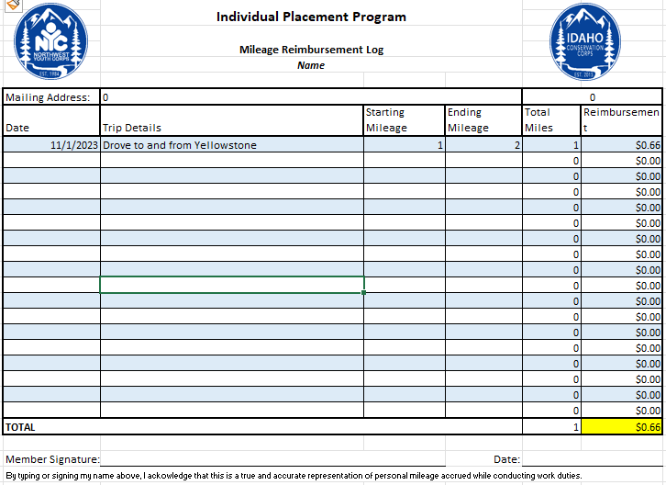
Mileage
Log
Notes:
Mileage log requires: date/date range, details of trip, starting and ending mileage on your vehicle.
We reimburse at the federal rate of $0.66/mile – this covers gas, wear and tear, and vehicle maintenance

Slide 16
Direct Hire Authority (DHA)
Objective: Via the DHA, Resource Assistants can be appointed directly to a General Schedule permanent, term, or temporary position.
Can request after 960 hours
Provide unofficial transcript showing degree (associate’s or higher)
Successfully fulfilled the requirements of the program*
Usable for 2 years after signature date or last day of internship, whichever is first
Notes:
* If looking to change departments, there may be some limitations
Procedure:
This authority allows candidates to non-competitively convert to a permanent position with the U.S. Forest Service, but it does not eliminate the Resource Assistants from the Non-Competitive Eligibility (NCE).
The DHA is used to make appointments to General Schedule positions on a permanent, term or temporary basis if the resource assistant has:
Completed a rigorous assistantship of at least 960 hours,
Successfully fulfilled the requirements of the program, and
Earned an undergraduate (associate or bachelor) or graduate degree from an accredited institution of higher education
Upon demonstration of these requirements, the employer of record shall provide both the mentor and Regional RAP Coordinator the following:
Transcripts that validate the RA holds a degree from an accredited institution,
A letter of completion, highlighting the position the RA held, the location of the position and the number of hours completed, and
Proof of hours worked (no less than 960)
The Regional RAP Coordinator will review and vet that the RA qualifies for the DHA. Once vetted, the regional coordinator will prepare the DHA certificate and route to the appropriate Regional Area Director.
The signing authority has been delegated from the Regional Forester to Regional Area Directors. Forest Supervisors do not hold signing authority of DHA certificates. The letter delegating signing authority is included as Attachment A.
Once signed, the Regional RAP coordinator will see that the DHA certificate is routed to the following inboxes, (upon hitting the Submit button on the bottom of the unsigned DHA certificate):
The RA themselves,
National RAP Manager,
RAs Mentor(s), and
Employer of Record Point of Contact(s)

Slide 17
2024 Webinar Schedule and Content
2024
Webinar 2024 Topics and Approximate Dates
Early June
Mixer/Meet and Greet
Mid June
Federal Resumes (Announce Photo Contest Opportunity Start)
Early July
USAJOBS and Hire Authorities
Mid July
Handshake, LinkedIn, Job Boards, Certifications and Future Opportunities
Early Aug.
Guest Speaker NPS (Announce Photo Contest Winners)
Mid Aug.
Guest Speaker USFS
End Aug./ Early Sept
Cover Letters and Mock Interviews
Mid Sep.
End of the Year Wrap Up

Slide 18

Partner Resources Website
https://www.nwyouthcorps.org/partner-resources-page/
Policies
Forms
Contact Information
More information surrounding our program

Slide 19

Intern Resources Website
Intern Resources (nwyouthcorps.org)
Past Webinars
HR Forms – Worker’s Comp Guidance, Return to Work Release
Professional Development
Career Resources
Feedback

Slide 20
Check-Ins and Site Visits
One-Month Check-In
Automatically sent from AirTable
Mid-Term Evauation
Automatically sent from AirTable at half-way point for RA
Evaluation
Sent around last week of internship.

Slide 21
Anticipated Site Visit Weeks & Intentions
OR/WA – June 24th to 28th
ID – July 8th to 12th
The Director and your Program Coordinator will plan to visit as many sites as possible during scheduled week for your state (though we may not get to all). We will be reaching out prior to travel to communicate plans and collaborate with supervisors.
This is a time to showcase what your intern has been doing at their assigned location and is a great time for NYC to meet supervisors and familiarize themselves with all you do.
We would love to get some great photos of interns in action and have a meeting with supervisors and interns to check in and touch base.
Notes:
Your Program Coordinator and I are planning to visit as many sites as possible during scheduled week for your state (though we may not get to all).
For ID: JULY 10-14th
And OR & WA: JULY 23-28th
This is a time we are hoping to showcase what your interns have been doing at their assigned location and is a great time for NYC to meet supervisors and familiarize ourselves with your site.
We have been on tours of work sites and helped with plant surveys and other projects so feel free to put us to work if you like while we are there!
During this time We would love to see interns in action.
Get some great photos and have a short meeting with supervisors and interns to check in and touch base.
We will be reaching out 1-2 months prior to communicate plans and collaborate with supervisors to coordinate schedules.

Slide 22
Questions for NYC?
Contact Information:
Lev Kellendy (Internship Program Director)
levk@nwyouthcorps.org
Abi Snow (OR/WA Internship Program Coordinator)
abigails@nwyouthcorps.org
Matthew Schlegel (ID Internship Program Coordinator)
matthews@idahocc.org

