Slide 1

NYC Site Supervisor Orientation & Information Session
2024

Slide 2
Introduction
The team
The intention of this meeting
Resources discussed here will be sent to your email after this webinar, including the presentation slides, a recording of this webinar, emergency phone numbers, and a link to our website where most important forms are located.
Notes:
Introduction:
I’m going to go ahead and get started,
Welcome all thank you for taking the time today.
Let me introduce the NYC team, Liv Kelly our ID area program coordinator, Kate Sanders our OR & WA program Coordinator, and myself, Sarah Worthington the Interns program Director
I am happy to have you here with us
We want to start having these orientations annually so that our partners understand our needs
And how we can support you and the interns in having a great experience
We also want to eliminate some stressful and chaotic situations that have been prevalent because of lack of communication or structure on our part
Please note that the Resources discussed here will be sent to your email after this webinar, including the presentation slides, a recording of this meeting, emergency phone numbers, and a link to the private resources page of our website where important forms are located for your use.
Today we also have a special guest speaker, Cathy Peterson the Education Specialist from Lewis & Clark National Historical Site.
Cathy is one of our site supervisors, and supervises 3-5 interns per year
She does a wonderful job of creating an exceptional learning environment and seizing every opportunity to enrich their experiences in the park
I asked Cathy to share the steps that her and other supervisors take to create that environment
My hope is that this information from Cathy’s experience may spark an idea or inspire you all to adopt or create something similar for your interns if you find it helpful
So please welcome Cathy Peterson, she will kick us off
Cathy, take it away.

Slide 3
Extensions, Modifications, & Intern Requests
PLEASE BE AWARE:
the more time we have for recruitment, the better, but we need a minimum of 4-6 weeks to recruit for a new position. Please factor this into timelines when requesting interns.
We would also like notification of a MOD or extension 2-4 weeks prior to term end dates, we cannot guarantee successful execution within 2 weeks of expiration or fund depletion.
Only extensions that are 8 or greater weeks can be added to an intern’s term
Notes:
All of this reduces stress and creates less chaos
And will help you get what you need when you need it.

Slide 4
Please communicate with NYC Intern Staff Immediately for the following Circumstances
If the intern makes or is involved in a sexual harassment or discrimination complaint
If there are problems with performance, behavior, or absenteeism
If there is a change needed in the length of a term or if a personal emergency arises for the intern
If there is a change in site supervisor
Notes:
THANKS CATHY! I hope you all can find something valuable and actionable in Cathy’s methods,
I certainly think there is a lot of value in her practices.
I ask that you all hold questions until the end if you wouldn’t mind.
I am going to jump right into the next portion
It is imperative that NYC be notified of certain situations to collaborate with our partners as the employer of record.
Please be aware that we need to be notified as soon as possible when certain scenarios arise
Such as,
1. If the intern makes or is involved in a sexual harassment or discrimination complaint
we would need to involve our HR Officer as early on as possible.
2. If you experience problems with performance, behavior, or absenteeism
We need to know if there are performance issues so that we can support the intern and supervisors appropriately.
We will have to document events, help collaborate for resolution, and support the partner with termination if necessary.
3. If there is a change needed in the length of a term or if a personal emergency arises for the intern
Absences or changes to start or end dates may affect stipend and time sheet approval,
If they are Americorps, this can affect an intern’s ability to complete their term and we may need to create a workplan for them to retain their education award
4. If there is a change in site supervisor we will need to redirect timesheet and production approval emails to ensure that timesheets and production will be approved on time
so please let us know when these things pop up for you so we can help

Slide 5
Emergency protocols for NYC Interns
Follow agency emergency procedures
Notify Northwest Youth Corps Program Coordinator as soon as possible
For on-going or unresolved emergencies (such as an evacuation or fatality) after business hours, please call the NYC emergency phone @ (541) 968-6520
Complete and return Worker's Compensation/Incident Reporting form as appropriate within
Important forms and the E phone number is located on the private link given out in onboarding emails, please bookmark this for future use as it is not a public page!
Notes:
In cases of field or other emergencies involving interns you supervise,
First, of course, please follow all your internal emergency protocols,
then
Please communicate with the interns staff by phone as soon as possible
This will help NYC communicate with family and the public as appropriate in sensitive situations
For emergency communications after business hours, please call the NYC emergency phone number to inform us of an incident.
The Ephone is staffed nights and weekends
So someone should be available to you
If you need to complete and submit Worker's Compensation/Incident Reporting forms for injuries, near-misses, or accidents
The form is located on the NYC website in our Intern/partner resources pg.
that will be shared with you after the meeting.

Slide 6
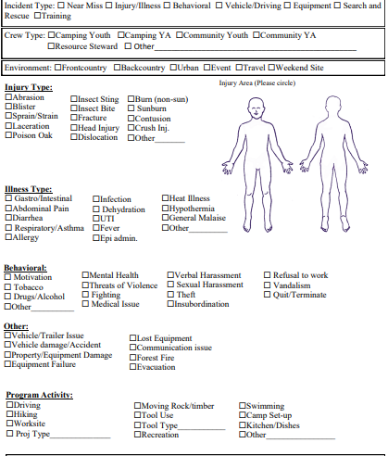
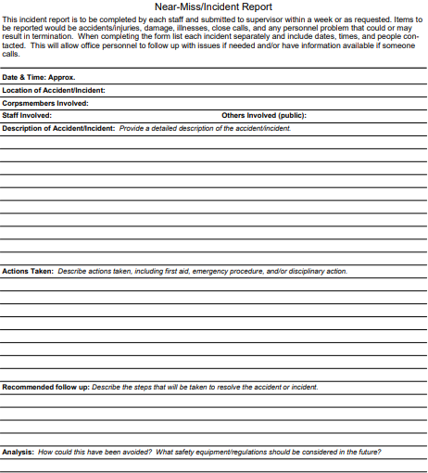
Incident Report Form
Notes:
Highlight the learning opportunity with these incident forms
Also usable for behavioral incidents/ interpersonal incidents

Slide 7
NEW ATTENDANCE POLICY IN EFFECT
- Interns will be screened by NYC staff and potentially be allowed approved absences if they are communicated prior to enrollment in the program AND if the partner is able to accommodate them by shifting their workplan.
All absences must be approved prior to enrollment and will result in a prorated stipend.
All other absences will not be approved and must be made up, contingent on available work and flexibility in timelines.
This is meant to address problems with absenteeism and to hold members accountable to the terms of their service.
The full policy will be given to you in the follow up email.
Notes:
Big Takeaway – If an Intern is needing time off, please keep us in the loop
If AmeriCorps, then can only miss a small percentage of time and still receive the education award.
Average of 40 hours per week
Observe all Federal Holidays

Slide 8

Remote Work Policy
Due to limitations surrounding worker’s compensation
Interns must live in:
ID
OR
WA
- If an intern lives in one state, but works in another, we recommend talking to a tax specialist if you have questions on withholdings.

Slide 9
Background Checks
The top candidate selected by our partners will undergo a national criminal background check through NYC prior to their hire date
If reports are found, NYC will utilize a hiring matrix to determine continued eligibility for onboarding. Site supervisors will be notified via email regarding reports found and if it is allowable based on our eligibility matrix. If it is an allowable report, we will require your approval prior to onboarding based on the duties of the intern and your internal policies.
Additionally, there is an appeal process for those individuals that may be denied.
If the results have not come back by the anticipated start date, we will have to delay the intern's start until results have been received and approved.
To avoid this issue, please give minimum 2 business days between candidate selection and anticipated start date.
Notes:
For individual placements and RAP interns (no change for AmeriCorps background check process FYI).
The top candidate selected by our partners in the interview process will undergo a national criminal background check through NYC prior to their hire date
Results will be given to the site supervisor via email for approval,
NYC will not screen for the agency or organization.
Meaning if a they have something pop up in their background check, NYC will not be deciding if they will be hired or not.
This will be up to the partner based on the duties of the intern and your internal policies.
If the results have not come back by the anticipated start date, we will have to delay the intern's start until results have been received and approved by you.
To avoid a start date delay, please allow a minimum of 2 business days between candidate selection and anticipated start date.

Slide 10
Orientation & Exit with NYC
We ask that you please plan for the top of the first & last day of the intern’s term to be available for orientation and exit with NYC, this will typically take around 1 hour. After, they will be released to the site supervisor.
This will help us ensure we have all the needed paperwork for compliance and that the intern will understand expectations from the beginning.
If this is a problem, please let us know! We can work with you for unique circumstances.
** Important note! Please make sure your intern is set up for success with access to a computer and internet connection to participate in orientation and exit and to input their monthly timesheets and production reports for your approval.
I-9 requirements have changed and now require a physical copy of ID documents to be seen on the first day. We appreciate your assistance in helping us stay in compliance.

Slide 11
Timesheets
Timesheets and Production logs need to be signed submitted and approved by the 20th of the month (especially for AmeriCorps!
Time approved by a supervisor is what will be paid, so please be vigilant about time approval and accuracy of hours worked.
Notes:
The changes should only eliminate the need for printing to sign timesheets making approval easier.
We will make sure that interns and supervisors receive necessary training when we make our jump to the new system.
Please stay tuned for those changes anticipated in mid-Spring.

Slide 12
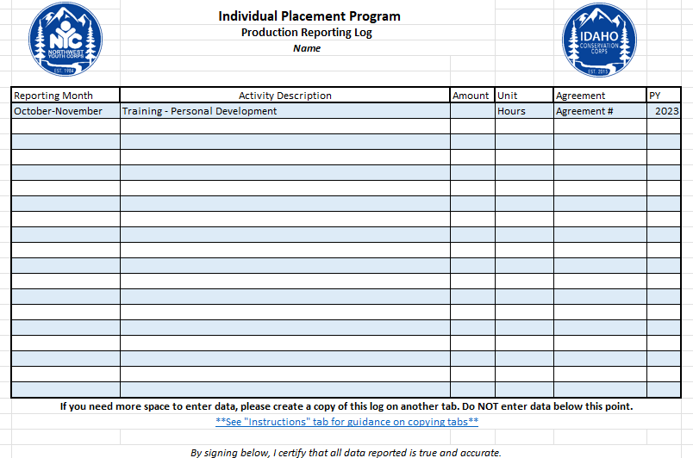
Production Reporting Reminders
3-5 activities per month, approximate
Can upload directly to database OR record in Timesheet Workbook and email monthly
Monthly Reporting Form (airtable.com)
Notes:
Looking for 3-5 items, approximate report

Slide 13
Reimbursement Policy
Must be pre-approved by supervisor via email
Submit receipts to AirTable link or email directly to coordinator
Must be an itemized receipt
Mileage reimbursement requirements:
Driver Record Check (one time during onboarding)
Must pass a Driver Training Course (one time)
Driver License Upload (with every submission)
Auto Insurance Card/Policy Upload (with every submission)
Mileage Log (with every submission)

Slide 14
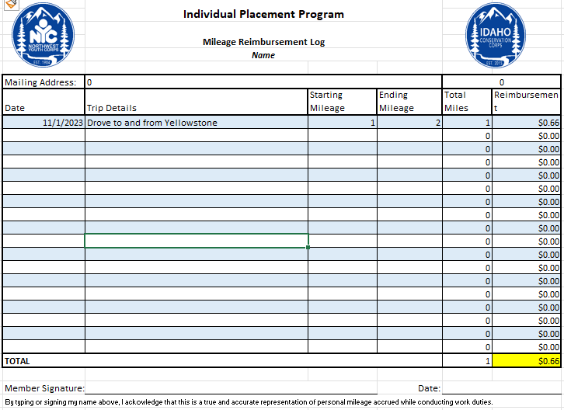
Mileage
Log
Notes:
Mileage log requires: date/date range, details of trip, starting and ending mileage on your vehicle.
We reimburse at the federal rate of $0.66/mile – this covers gas, wear and tear, and vehicle maintenance

Slide 15

Public Lands Corps Non-Competitive Hiring Authority (PLC)
Objective: Via the PLC, participants can utilize this hiring authority through USAJOBS to appointed to permanent positions
Can request after 640 hours
Must complete and submit verification form
NPS form requires a work log and supervisor signature
Successfully fulfilled the requirements of the program
Usable for 2 years after signature date or last day of internship, whichever is first

Slide 16
2024 Webinar Schedule and Content
2024
Webinar 2024 Topics and Approximate Dates
Early June
Mixer/Meet and Greet
Mid June
Federal Resumes (Announce Photo Contest Opportunity Start)
Early July
USAJOBS and Hire Authorities
Mid July
Handshake, LinkedIn, Job Boards, Certifications and Future Opportunities
Early Aug.
Guest Speaker NPS (Announce Photo Contest Winners)
Mid Aug.
Guest Speaker USFS
End Aug./ Early Sept
Cover Letters and Mock Interviews
Mid Sep.
End of the Year Wrap Up

Slide 17

Partner Resources Website
https://www.nwyouthcorps.org/partner-resources-page/
Policies
Forms
Contact Information
More information surrounding our program

Slide 18

Intern Resources Website
Intern Resources (nwyouthcorps.org)
Past Webinars
HR Forms – Worker’s Comp Guidance, Return to Work Release
Professional Development
Career Resources
Feedback

Slide 19
Check-Ins and Site Visits
One-Month Check-In
Automatically sent from AirTable
Mid-Term Evauation
Automatically sent from AirTable at half-way point for RA
Evaluation
Sent around last week of internship.

Slide 20
Anticipated Site Visit Weeks & Intentions
OR/WA – June 24th to 28th
ID – July 8th to 12th
The Director and your Program Coordinator will plan to visit as many sites as possible during scheduled week for your state (though we may not get to all). We will be reaching out prior to travel to communicate plans and collaborate with supervisors.
This is a time to showcase what your intern has been doing at their assigned location and is a great time for NYC to meet supervisors and familiarize themselves with all you do.
We would love to get some great photos of interns in action and have a meeting with supervisors and interns to check in and touch base.
Notes:
Your Program Coordinator and I are planning to visit as many sites as possible during scheduled week for your state (though we may not get to all).
For ID: JULY 10-14th
And OR & WA: JULY 23-28th
This is a time we are hoping to showcase what your interns have been doing at their assigned location and is a great time for NYC to meet supervisors and familiarize ourselves with your site.
We have been on tours of work sites and helped with plant surveys and other projects so feel free to put us to work if you like while we are there!
During this time We would love to see interns in action.
Get some great photos and have a short meeting with supervisors and interns to check in and touch base.
We will be reaching out 1-2 months prior to communicate plans and collaborate with supervisors to coordinate schedules.

Slide 21
Questions for NYC?
Contact Information:
Lev Kellendy (Internship Program Director)
levk@nwyouthcorps.org
Abi Snow (OR/WA Internship Program Coordinator)
abigails@nwyouthcorps.org
Matthew Schlegel (ID Internship Program Coordinator)
matthews@idahocc.org

