Slide 1
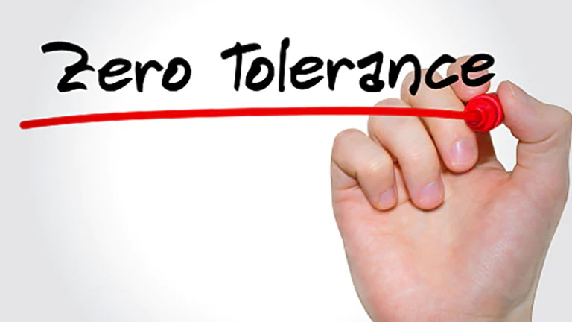

HARASSMENT
What is it?
What if it happens to me?
How can I help?

Slide 2

Jessie Johnson, HR Officer
Contact:
Phone: 541-654-4712
Email: jessicaj@nwyouthcorps.org

Slide 3

It happens other places… but not here… right?
Discrimination and Harassment are real and can happen at NYC.
Sexual harassment is a chronic workplace problem.
Only 1 in 4 victims report, so the actual number of incidents is far higher than the official number of complaints.
Recently a law, known as #Metoo has made changes. Highlights include ensuring victim knows how to report and have a 5 year window to report (statute of limitations).

Slide 4
Harassment and Discrimination are Prevalent in the Workplace (2019 Stats)
Total Harassment and Discrimination Cases: 72,675
Disability: 24,238 (33.4 percent)
Race: 23,976 (33.0 percent)
Sex: 23,532 (32.4 percent)
Age: 15,573 (21.4 percent)
National Origin: 7,009 (9.6 percent)
Color: 3,415 (4.7 percent)
Religion: 2,725 (3.7 percent)
* These percentages add up to more than 100% because some charges allege multiple bases.

Slide 5
How does it all breakdown?
All Employees of NYC:
NYC Policy (reach out to your Supervisor and/or NYC HR Officer). Also provided during this training.
All Americorps Volunteers/Interns:
Americorps Policy (reach out to your Supervisor- can access NYC HR Officer)
Participants: Training will be provided. Any romantic relationship, consensual or otherwise is NEVER okay. Can and will result in termination/dismissal.

Slide 6

Important Definitions
Gender identity is the personal sense of one's own gender. Gender identity can correlate with assigned sex at birth or can differ from it.
Sex refers to physical or physiological differences between male, female, and intersex bodies, including both primary sex characteristics (the reproductive system) and secondary sex characteristics (such as breasts and facial hair).

Slide 7
Legally, there are two types of harassment
  Quid pro quo - Latin for “this for that.” It is requests for sexual acts in return for favoritism in employment.
  Hostile Work Environment - behavior that creates a hostile, intimidating or offensive work environment.
Consists of:
    Severe and pervasive conduct
    Unreasonable interference with an individual’s job performance
Considerations:
    How frequent is the conduct?
    How severe is the conduct?
    Is the conduct physically threatening, humiliating, or merely an offensive utterance?
    Does the conduct unreasonably interfere with an individual’s work performance?

Slide 8
Sexual and Sex Harassment
Sexual Harassment: Any unwelcome sexual advance or conduct on the job that creates an intimidating, hostile, or offensive working environment.
  Includes any unwelcome:
    Sexual advances
    Requests for sexual favors
    Verbal and physical conduct of a sexual nature
    Display of sexually explicit or suggestive materials
Sex Harassment: Not sexual, it is harassment based on sex. This can be rude, abusive or intimidating behavior.
  Includes any unwelcome speech, gestures, or behaviors:
    Refusal to use preferred pronoun
    Assignment of duties based on sex
For example: A supervisor gives demeaning and/or inappropriate assignments (such as serving coffee, picking up dry cleaning, emptying a waste basket) to the woman, but not to the man, because of the woman’s sex.

Slide 9

Sexual Orientation Harassment
Sexual Orientation Harassment: Harassment based on someone’s sexual orientation.
Includes:
    Stating or implying in a joking or negative manner that an employee is a gay, lesbian, bi-sexual, transgender, gender non-confirming or heterosexual individual.
    Making jokes about gay, lesbian, bi-sexual, transgender, gender non-confirming or heterosexual individuals.
    Inquiring into the sexual practices of an individual.
    Repeatedly expressing negative opinions about gay, lesbian, bi-sexual, transgender, gender non-confirming or heterosexual individuals.

Slide 10


Who can commit harassment?
ANYONE!
Who can experience harassment?
ANYONE!
Harassment is experienced by:
Direct targets of harassment
Bystanders/Witnesses: those that witness acts of harassment directed toward someone else may bring a harassment case

Slide 11

What should I do?
Supervisors are responsible for the inappropriate remarks or actions of the people who work for them.
Employees must take reasonable steps to avoid harm.
If you are a victim of harassment:
Ensure that you are in a safe place.
Consult employee policy (included in employee handbook).
Put details in writing (the more detail the better).
Explain the exact behavior offending you, and tell them to stop (if you are safe to do so).
Talk to your supervisor.
Reach out to the Human Resources Officer.

Slide 12
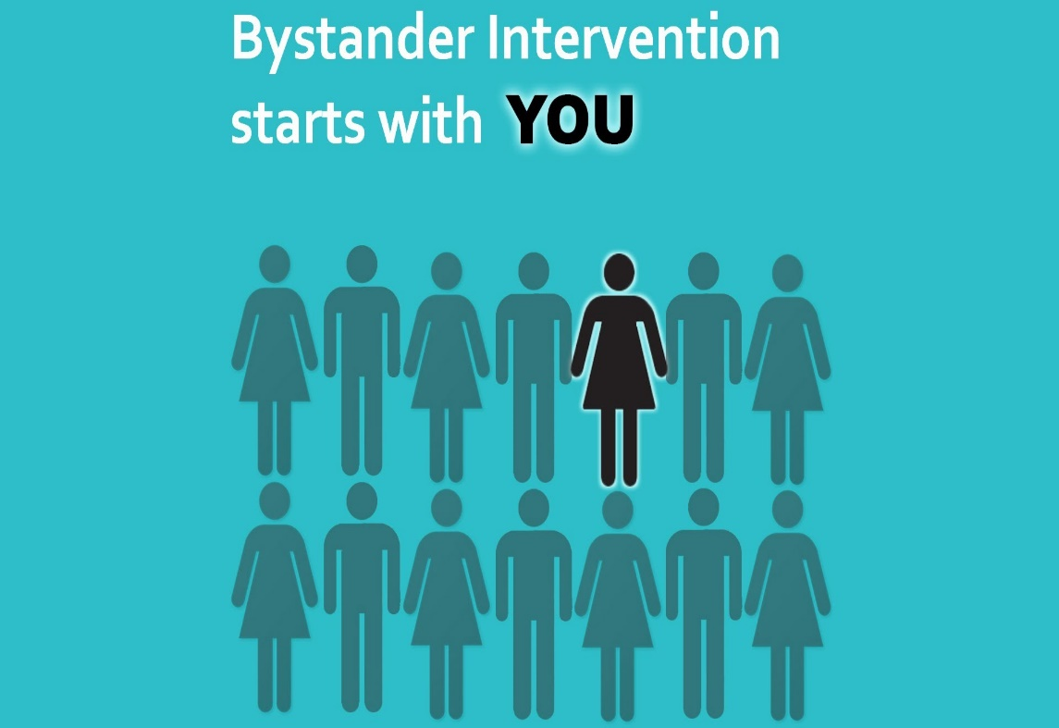
What if you’re not the victim or the harasser?
Bystander Intervention- You can make a difference!
People can interrupt behaviors to prevent harassment.
ALSO people make decisions and continue behaviors based on the reactions they get from others.

Slide 13
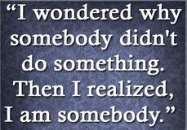
If you see harassment….
Only intervene if you feel safe to do so.
Talk to the harasser later, by asking questions but not lobbing accusations: “Were you aware of how you came off in that conversation?”
Disrupt the situation, such as by loudly dropping a book or asking the victim to come to the conference room.
Report harassment! Particularly if it feels unsafe to directly intervene.
Talk openly about inappropriate behavior, like asking colleagues: “Did you notice that? Am I the only one who sees it this way?”
One crucial element, is for bystanders to talk to targets of harassment. Ask the victim if they are okay or need help reporting. Give them support.

Slide 14
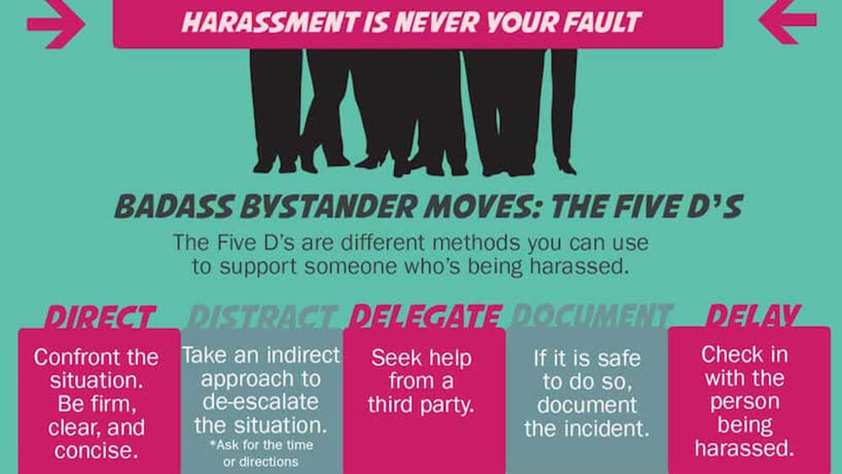
Bystander intervention is not about putting yourself in harms way
Only intervene in ways you are safe

Slide 15
Final Thoughts and Review
To be considered harassment, the behavior must be UNWELCOME
Harassing behaviors are weighed on scales of SEVERE and PERVASIVE
ANYONE can be a victim
ANYONE one can be a harasser
Bystander intervention CAN prevent harassment from escalating.
Important points to remember:
  Harassment can be physical, verbal or visual conduct.
  It is anything of a sexual nature in the workplace that is not welcome.
  Harassment is unlawful.

Slide 16
What Should I Do???
https://www.youtube.com/watch?v=akFebZtIUX8
https://www.youtube.com/watch?v=_dvvzxJm8qA 1 min in
https://www.youtube.com/watch?v=ZZ7-wzb0Az8 End 1:20
https://www.youtube.com/watch?v=85BGquQb_K0
https://www.youtube.com/watch?v=tCQNciBBpu4

Slide 17

Jessie Johnson, HR Officer
Phone: 541-654-4712
Email: jessicaj@nwyouthcorps.org

