Slide 1

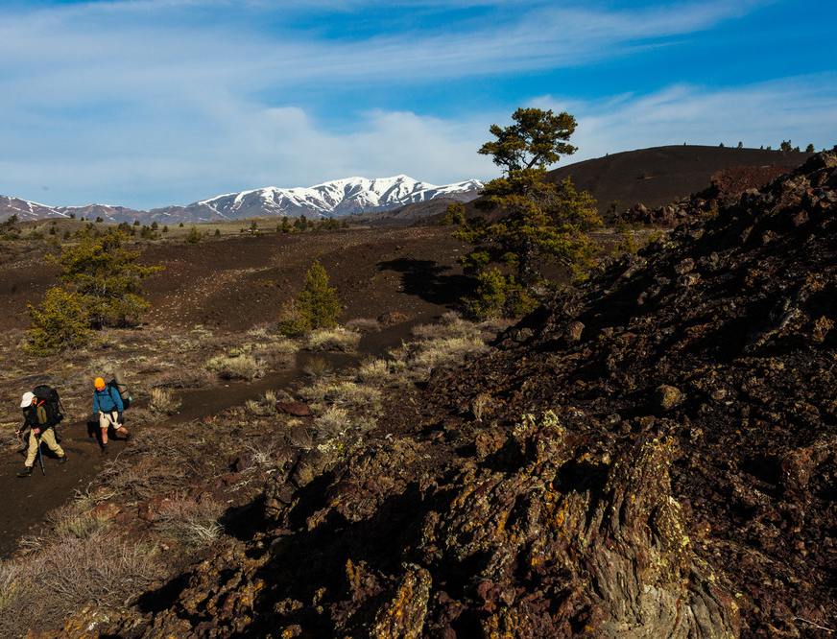
Northwest Youth Corps Intern Drivers Training

Slide 2
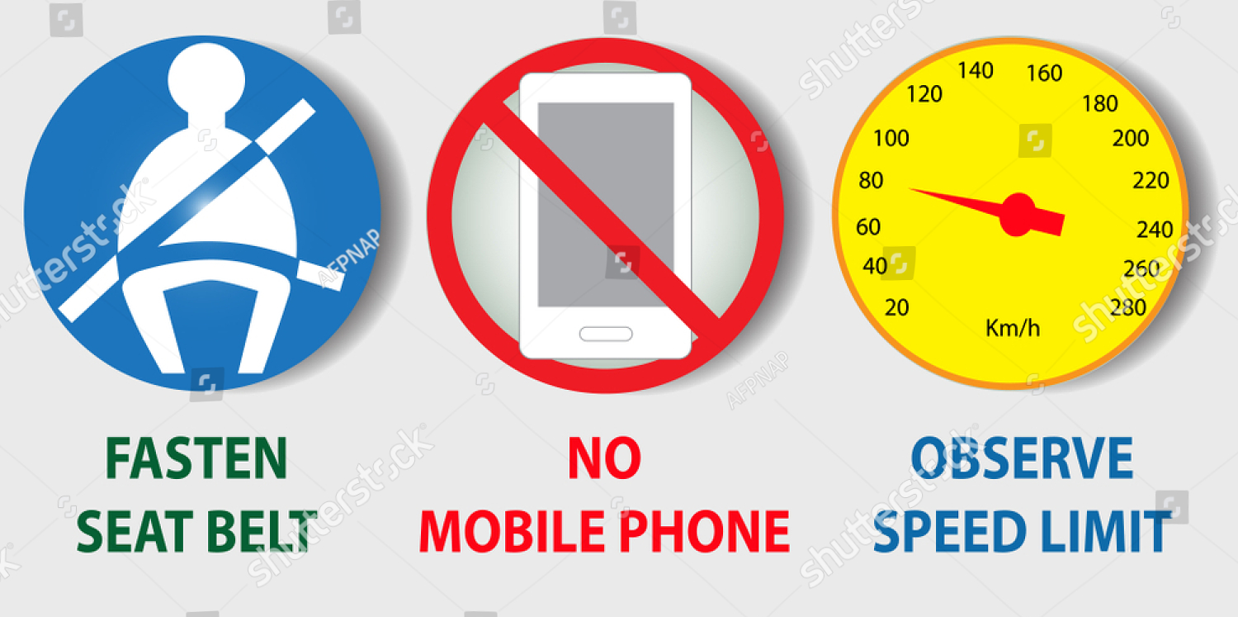
Goals of Drivers Training
Ensure that each driver is fully aware of NYC’s driving policies and protocol
To provide the safest experience possible to our Interns.
SAFETY IS OUR #1 GOAL!

Slide 3
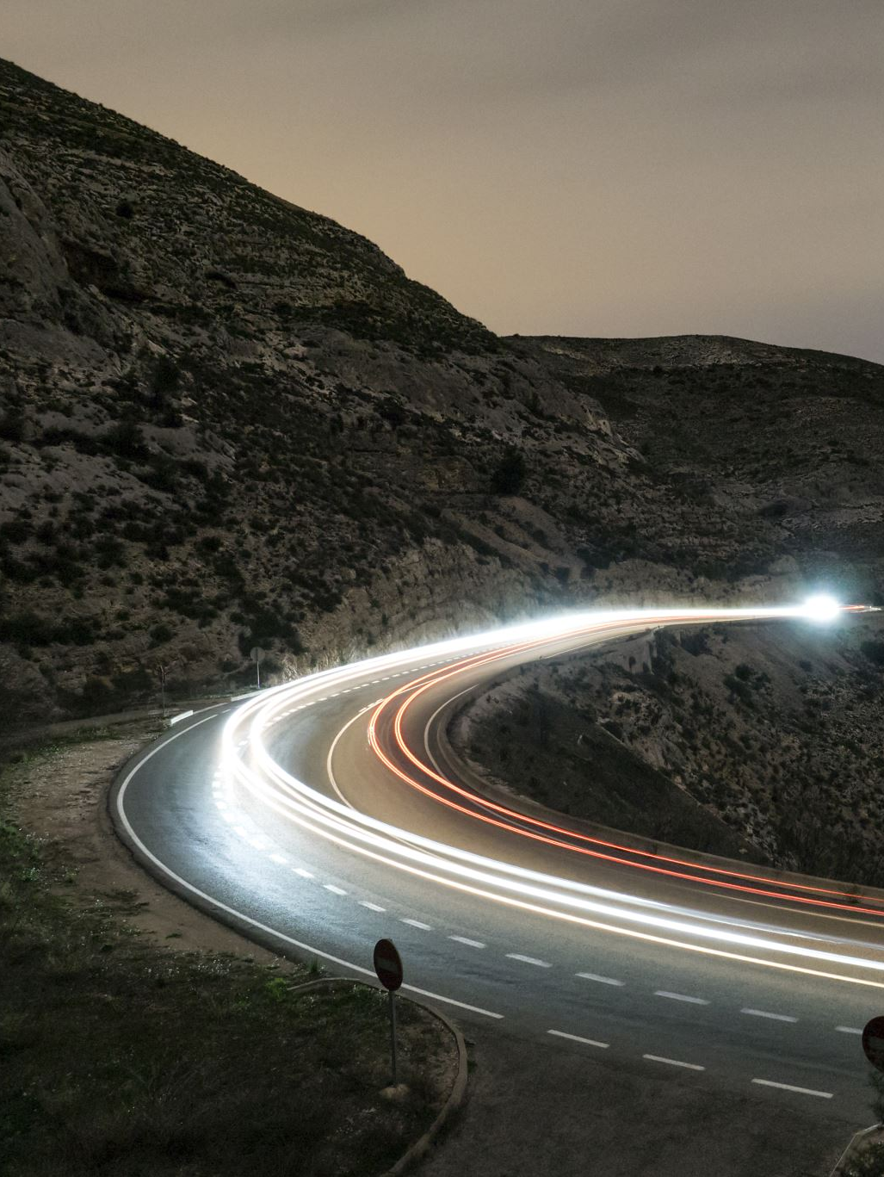
Driving Safety
Driving is and will be the most dangerous activity you’ll do within your term of service, drive defensively.
Give yourself more time to get places, know where you’re going.
If driving longer distances, take appropriate breaks, do not drive tired.
Obey all traffic laws, speed limits and expectations.

Slide 4
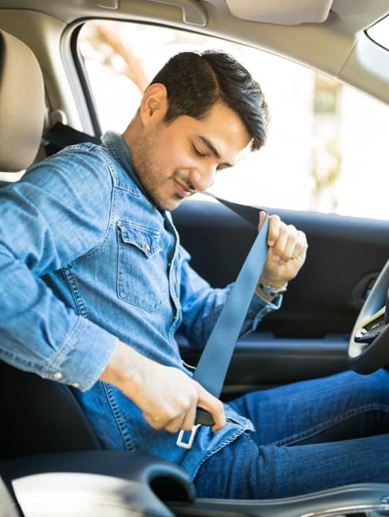
Driving On the Job:
No Cell phones! Utilize hands free, Bluetooth etc.
Seatbelts in use 100% of the time
Headlights on- Day or night
Use your mirrors and have them appropriately adjusted.
Follow speed limits, speeding is never acceptable
Sound judgment and decision making saves lives
Always anticipate danger, conditions can change rapidly.
Notes:
Why is driving at NYC the most dangerous activity? What is the best way to adjust your mirrors to avoid blind spots? NYC vehicles especially those that are hauling trailers are considered “trucks” hence truck speed limit maximum on interstates and highways

Slide 5
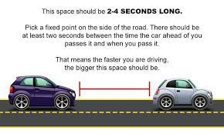
SPEED vs. TIME
55mph= 65 seconds per mile vs. 60mph= 60 seconds per mile- focus on time management rather than rushing to your destination.
Faster speeds reduce reaction time- It may take 120’ to stop a Subaru Outback at 60mph
Maintain proper spacing between vehicles (4 seconds or more between you and the vehicle ahead)
Drive for conditions and plan ahead for delays
Notes:
Always follow the directions on your specifications even if you believe there is a quicker or more effective route. Time management is imperative to meeting the goals and objectives of your crew while also preventing irrational decision making. What is a good way to gauge proper spacing between vehicles? Response: Using a land mark such as a mile maker you should be able to count 4 to 6 seconds before reaching the spot that the car in front of you has just passed. More distance = more reaction time.

Slide 6
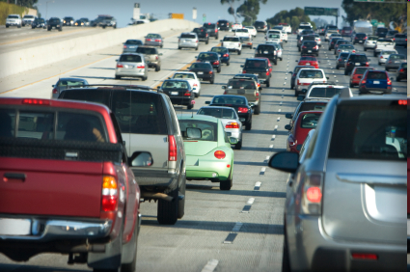

Slide 7
Traffic and congested roadways
Always leave yourself an out; the right most lanes are the safest position to travel
Drive for conditions
Leave space for others, maintain at least 4 car lengths distance between vehicles
Know where you are going
Be calm, spread calm

Slide 8
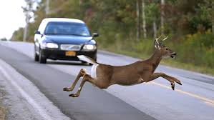

Slide 9
Animal interactions
Wildlife are most active at dawn and dusk, and may be more erratic during daylight hours
Headlights will illuminate eyes of animals at low light hours
If you see one animal, expect 10, herds will cross-roads
If distance from animals is ample, slow down, but do not make erratic or evasive maneuvers
If driving in areas of higher wildlife traffic, use greater caution, drive slower.

Slide 10
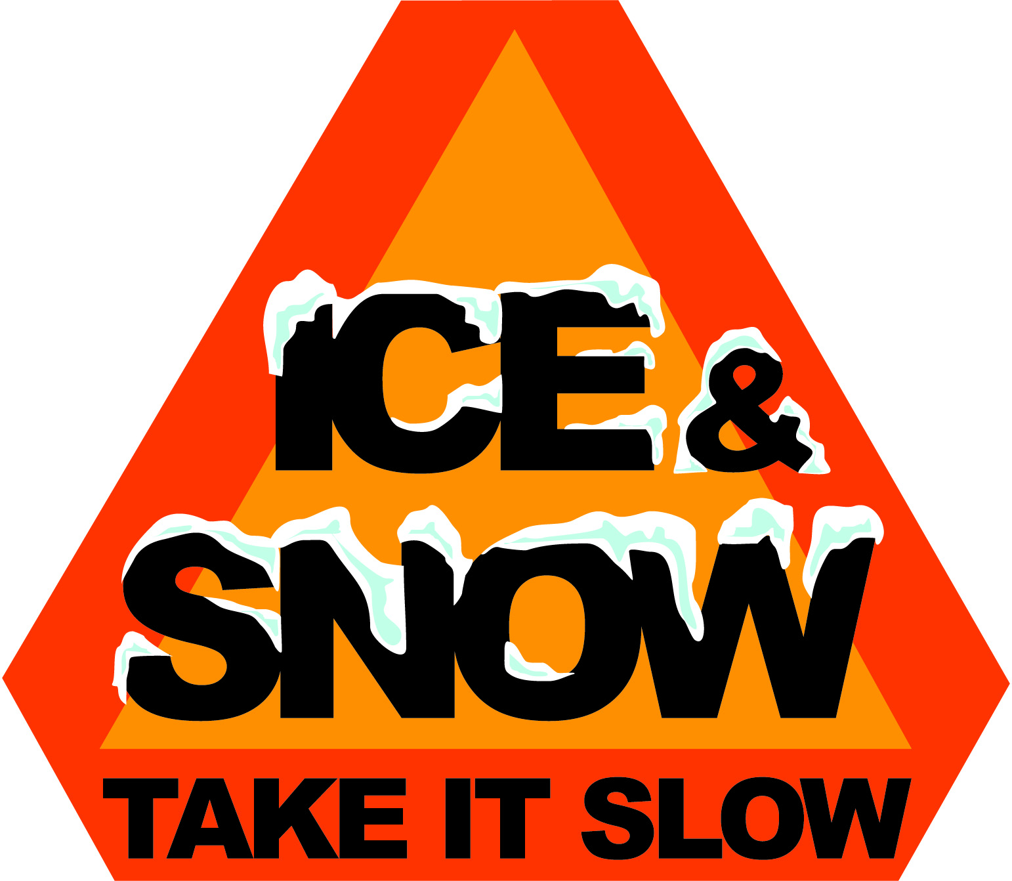

Slide 11
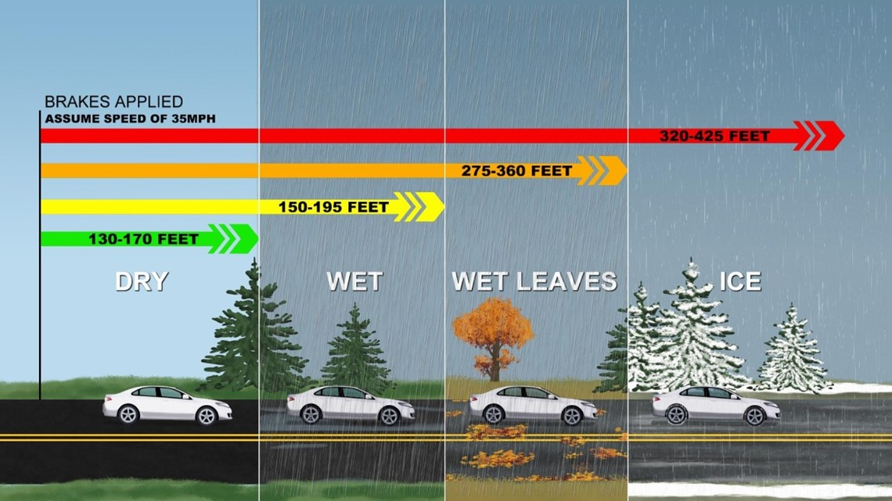
Adverse weather
Always drive for conditions, travel at slower speeds, maintain greater following distances
Use your headlights whenever driving- Day or Night
In thick fog use your hazard lights
Plan for delays and give yourself more time
If driving in snow or icy conditions, do not slam on brakes, pump them gently, steer into slides

Slide 12
Conditions can change rapidly, situational awareness is critical.
Know where you’re going, plan for rest breaks and fueling.
Notes:
? Not sure about this one

Slide 13
Emergencies
Brake Failure- use lower gears for longer downhill descents, do not ride brakes. Let brakes cool if needed
Tire Blowout- be aware of tire condition, maintain firm control of steering wheel, pull off in a safe spot.
Engine Issues- stay up to date on vehicle maintenance, make repairs before they are larger problems!
Imminent collision- Remain Calm, maintain control of vehicle, minimize impact as possible
Always leave yourself an out.
Notes:
Brake Failure
1. Take your foot off accelerator pedal.
2. Pump brake pedal repeatedly.
3. Shift to lower gear - continue to downshift.
4. Engage parking brake.
5. Steer against curb or embankment, if possible.
Tire Blowout
1. Keep a firm grip on the steering wheel.
2. Keep wheels as straight as possible.
3. Slow down gradually by pumping brakes lightly.
4. Reduce speed to 15 mph or less before pulling off onto shoulder.
Accelerator Sticks
1. Pump accelerator pedal with several sharp jabs to release it.
2. Try to pull pedal up with your toe.
3. Put in neutral, turn on emergency flashers, and sound horn to warn others.
4. Apply brakes and pull off highway.
Recovering From a Skid
1. Take your foot off of gas or brake pedal; avoid braking.
2. Steer in the direction in which you want the vehicle to go.
Blinding Lights
1. Flash your high beams to signal the approaching car, but don't leave them on; two blind drivers is worse than one.
2. Look at the right edge of the road.
3. Slow down.
Lights Fail
1. Try other lights such as high or low beam, turning signal, parking lights, fog lights, and brake lights. The problem may be in one of the switches.
2. Pull off the road and stop.
Imminent Head-on or Front Corner Collision
1. Steer until accident is unavoidable; if you can't avoid a collision, try to have a glancing impact, rather than a head-on impact.
2. Stay in vehicle (don't try to jump out; you are safer in the van)
3. Immediately before impact‑‑driver crosses arms over face and presses head and arms against steering wheel
4. Passengers in other seats cross arms over face and press head and arms against back of forward seat
Physical Emergencies Affecting the Driver
1. Dirt in eye, violent coughing and sneezing attack‑‑signal, slow down and stop, until condition is corrected
2. Dropped articles‑‑do not try to retrieve anything from the floor of vehicle while vehicle is moving. Stop; then recover or dispose of dropped item
Engine Stalls
1. Do not turn off ignition; shift to neutral.
2. Turn on emergency flashers.
3. Carefully steer onto the shoulder.
4. Use emergency brake to slow down and stop if necessary.

Slide 14
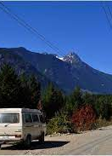
Driving on Forest Roads
Conditions and road surface can change rapidly- washboard, ruts, loose gravel, dust
Drive at speeds that maximize your ability to react. 25 mph is fast on these roads *is there a speed limit on FS roads?
Expect to encounter other drivers, logging trucks, recreationalists.
Use turn-outs in the roadway, give right-of-way to other vehicles

Slide 15
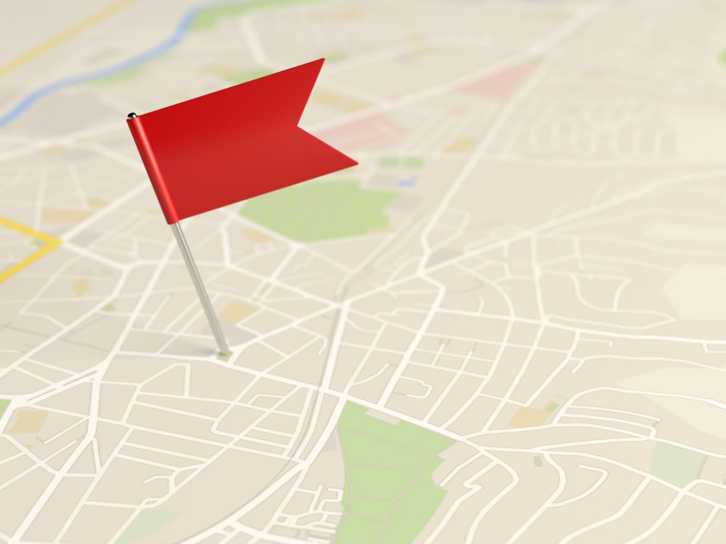
Navigation in Rural Areas and Public Lands
Getting lost or taking an unsafe route can be extremely dangerous and stressful
Plan your trip before you go!
How will you get to your destination without reliable cell service?
What ways can you navigate without relying on Google Maps?
Notes:
Once you leave a city, you cannot rely on your typical navigational systems (ie- Google maps, Waze) to get you and your crew safely to your destination. You may quickly lose cell service, meaning your phone cannot tell you where you are and keep you on your planned route. Or, the option suggested may be outdated, unsafe, or not even open!
Getting lost on poorly-marked roads where not many people travel can be extremely dangerous and stressful. Taking a suggested route that is confusing or poorly-maintained can turn a two-hour drive into a four-hour drive, leading to an exhausted and grumpy crew setting up camp late and cutting in to your recharge time.
It is important to plan your trip before you go with as much detail as you can gather, and with multiple sources of information.
For instance:
Check your Project Specs for directions, lat/longs, and other pertinent information. If they include specific route recommendations, then use them!
Ask your Woodsboss, PC, or Project Partner if there are specific routes you should use or avoid to get to where you are headed. They are usually your best source of information about road conditions and other factors.
Check Google maps for an approximate route and travel time. If you were told to follow a specific route, then add points along your travel path. Download the map onto your phone so you still have it in areas of spotty cell service.
Carry paper maps for your route and for the areas you will be working. These can include:
Motor Vehicle Use Maps (more info below)
Road atlases
Forest Service Recreation Maps
While driving, use your shotgun navigator to keep you on the correct route. If you think you may have gotten off course, pull over and reevaluate before continuing.

Slide 16
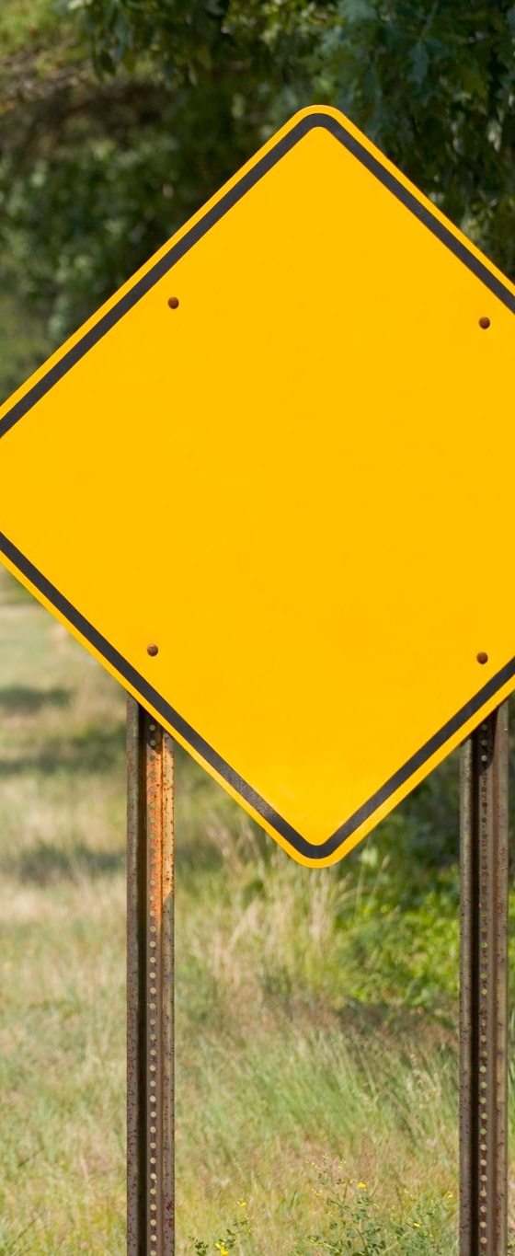
Fatigue, Overconfidence, and Distraction
Signs/Symptoms
Driving breaks
Take care of yourself
Social Pressures
Responsibility
Time Management
SAFETY IS OUR #1 FOCUS!!
Notes:
Rest periods- 15-minute breaks every two hours (if driving without a secondary driver, otherwise switch drivers)
1 hour break every four hours

