Slide 1





Resource Assistant Program
Orientation 2024
Region 6&4

Slide 2

Partnership
Forest Service
Facilitates RA Orientation to Forest Service
Promotes a Community of Learning
Provides Training
Review’s Performance
Approves Timesheets, Travel and Training Arrangements
Provides Mentorship & Professional Development
Northwest Youth Corps
Manages Intern Benefits (Payroll, Workers Comp, Health Insurance, etc.)
Provides Training and Professional Development Support (Distance and In-Person)
Conducts Site Visits
Tracks and Reports Performance (quarterly)
Resource Assistant Program (RAP) Intern
Works Collaboratively with USFS Staff to Complete Assigned Work Activities
Develops Professional Goals
Applies Critical Feedback to Improve Performance
Actively Participates in Meetings, Unit Activities and Other Events

Slide 3



Northwest Youth Corps
Mission:
Northwest Youth Corps and Idaho Conservation Corps offer a challenging education and job-training experience that helps youth and young adults from diverse backgrounds develop the skills they need to lead full and productive lives.
History:
Created in 1984 (Founder Art Pope)
Modeled after the historic Civilian Conservation Corps of the 1930's

Slide 4



Northwest Youth Corps & Idaho Conservation Corps
Youth and Young Adult Programming
Serve 1,000 participants per year 19 – 26
Residential and non-residential offerings
Accredited curriculum
Internship Programming
USFS Resource Assistant Program (RAP)
Conservation Internship Program
AmeriCorps Internship Program
Core Values
Education
Leadership
Community
Empowerment
Challenge
Operating Sites:
Eugene, OR
Tacoma, WA
Boise, ID

Slide 5

The Conservation Internship program is designed to provide hands-on training and experience to those interested in pursuing employment with land and water resource management agencies.
Terms are 3-10 months
Project types may include:
  Restoring and improving public lands and waters
  Invasive species inventory and treatment
  Trail maintenance and recreation infrastructure
  Community engagement
  Outdoor recreation
  Natural resource data collection
https://www.nwyouthcorps.org/internresources/

Slide 6

Member Benefits
Professional development
Mission-critical Forest Service assignments that demonstrate leadership, critical thinking, and strategic communication with supervisors and the public.
Work assignments comparable to at least a GS-04 grade level
Coaching and mentoring by site supervisors, mentors, and USFS networks
Career pathways
Two-years of Direct Hire Authority upon successful completion
  Can request after 960 hours
  Need to provide unofficial transcript showing degree
  Must request from NYC supervisor when you would like to receive it
  Usable for 2 years after signature date or last day of internship, whichever is first.
Additional
Monthly stipend
Relocation and training funds
Health insurance plan
Workers' compensation coverage

Slide 7
Reimbursement Policy
Submit receipts to AirTable link
Must be pre-approved by supervisor (by email)
Must be an itemized receipt
Mileage reimbursement requirements
  Driver Record Check
  Driver License Upload
  Auto Insurance Card/Policy Upload
  Must pass a Driver Training Course

Slide 8
Timesheets and Reporting
Pay period:
21st of the month to the 20th of the following month.
  Example: February 21- March 20, 2021
Payday: Last business day of each month
Sign and Date your timesheet.
Have your supervisor approve your hours
Scan and send timesheets via e-mail to your coordinator around the 20th of each month (electronic placeholder).
Mail original to your coordinator

Slide 9
Payroll and Timesheets
Digital placeholder timesheets (Due by 21st of each month)
IMPORTANT: Date your timesheets correctly
IMPORTANT: Wet-ink timesheets
Production Reporting/Timesheet Workbook
  Monthly Photo Upload

Slide 10
Payroll
Paychecks are transmitted via direct deposit on the last business day of the month
  Please upload a voided check or other bank statement that includes the account and routing numbers for verification
Resource Assistants may request a payroll draw by completing a Draw Request Form. Draws cannot exceed $400.
Requests need to be made early in the week if not enrolled in Draw Program
Pay Stubs: Intuit Payroll Services
  Emailed link that lasts for 10 days once received

Slide 11

Personal Leave & Grievance
Managing Interns Time:
Do not exceed an average of 40 hours per week
Observe Federal holidays
Coordinate making up sick days and or days off
PTO - 40 hours of leave/6 months of service are provided
Please email site and NYC supervisors for leave requests
Grievances Procedures:
Document the issue
Report to your site supervisor immediately
Notify Northwest Youth Corps if arbitration is needed

Slide 12
Attendance Policy
Attendance is a mandatory requirement ​
  Punctual and regular attendance is an essential responsibility of each member at NYC.​​
Member's will be subject to disciplinary action if either of the following occurs:​
  Unexcused absences exceed more than 10% of their expected service hours​
  Absences prevent you from meeting the minimum term requirements
An Excused absence is:
  An absence that has been pre-approved by your NYC point of contact and your Site Supervisor (Example: PTO, Federal Holiday).
  If you need a sick day, please let NYC know ASAP.
  Absences 5 days or longer may result in a suspension until you return. (Example: Sick time, extended leave.)

Slide 13
Workers Compensation
What should I do if I am injured during the scope of my work?
1. Immediately report the injury to your site supervisor
2. Contact Northwest Youth Corps
    Lev Kellendy, Office: 541-654-4706
    Matthew Schlegel, Office: 208-593-7622
    Abi Snow, Office: 541-654-4704
3. Get medical treatment at Urgent Care or Emergency Room
4. Tell medical staff you sustained a work-related injury and are covered under Workers Comp
5. Request Return to Work Release from the treating physician
6. Complete State based Workers Compensation Form
7. Scan documents to jessicaj@nwyouthcorps.org
Washington Labor and Industries
First report of accident and injury form
File at the clinic or emergency room
Request carbon copy
Oregon SAIF
801 Form (employee section)
Northwest Youth Corps will file on your behalf
Idaho SIF
Fill out the First Report of Injury or Illness Form
Request a Return to Work Release Form from healthcare facility

Slide 14

Health Insurance
Enrollment
Complete Ascension Enrollment Form – Section 1 Employee Information
Choose your provider –You receive better benefits based on discounted charges when you choose a Preferred Provider from CIGNA’s Open Access Plan (OAP) network. To look up a specific provider or obtain a list of preferred providers, please visit www.cigna.com or call 1-800-244-6224
Make the appointment – When asked, your insurance provider is CIGNA.
Preferred Provider Network: CIGNA OAP
Group #: 3338030
Claims Processor/Administrator: CIGNA
Member ID #: Your Social Security Number
Bring your ID card to the provider’s office/facility. If you have lost your ID card or have not received one, print a temporary ID card from myCigna.com or use the myCigna mobile app.

Slide 15
Non-Discrimination Policy
NYC does not discriminate in program admission based on race, color, sexual orientation, military discharge, sex, national origin, age, disability, or any other characteristic
NYC and our sponsors will make reasonable accommodations and encourage you to bring up any questions or concerns regarding issues related to discrimination or harassment (including sexual harassment).
  Sexual Harassment is defined as:
  “unwelcome sexual advances, requests for sexual favors, and other verbal or physical conduct of a sexual nature ... when ... submission to or rejection of such conduct is used as the basis for employment decisions ... or such conduct has the purpose or effect of ... creating an intimidating, hostile or offensive working environment.”
Discrimination or harassment of any kind will not be tolerated.
Anyone found to be engaging in any type of unlawful or harassing discrimination will be subject to disciplinary action, up to and including dismissal from the program.
Mandatory Reporter Policy

Slide 16
Uniform and Dress Code
You will receive:
Some notes:
Long-sleeve
Short-sleeve
Trucker hat
Pin
Partner requirements
Ambassadorship

Slide 17
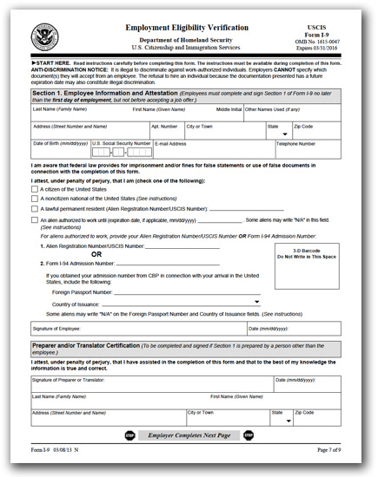
Paperwork
Hire Letter
I-9 (Need copies of Identifications – N/A’s)
W-4
Direct Deposit
Payroll Draw Program (If Applicable)
Cigna health plan enrollment
Acknowledge and release
Code of Ethics
Memorandum of Understanding
Emergency & Contact Information
Medical Information
Scan all documents into an e-mail to matthews@idahocc.org or abigails@nwyouthcorps.org
Send original paperwork:
OR/WA – Abi Snow, Northwest Youth Corps, 2621 Augusta Street, Eugene, OR 97403
ID – Matthew Schlegel, Northwest Youth Corps, 6051 W Corporal Ln Boise, ID 83704

Slide 18
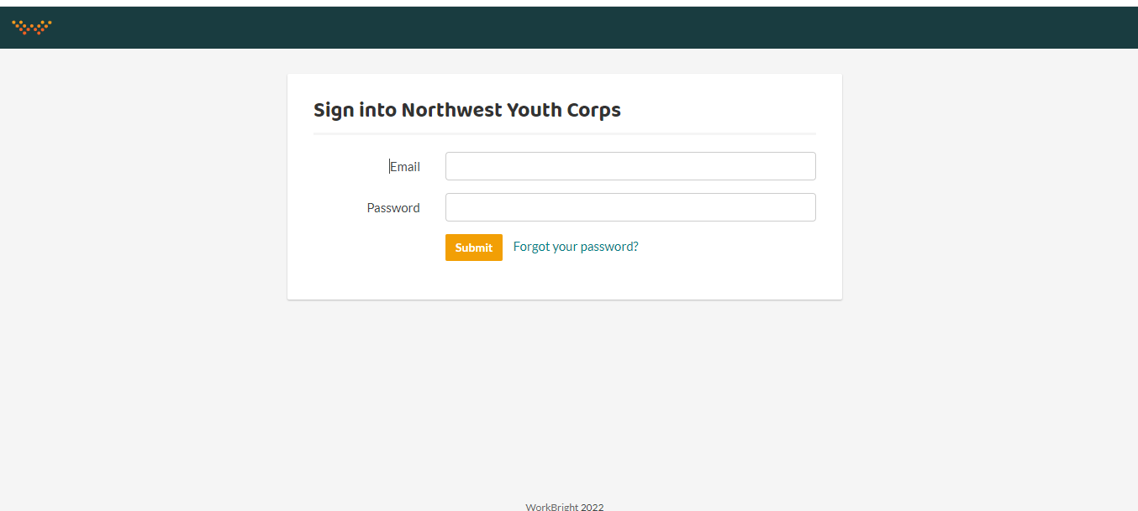
WorkBright Onboarding
Go to https://nwycorps.workbright.com/
If you forgot your password, please click “Forgot your password?” for a quick email to reset it

Slide 19
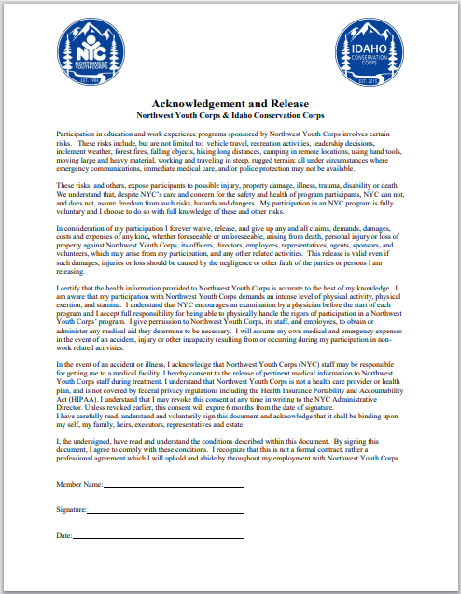
Acknowledgement and Release

Slide 20
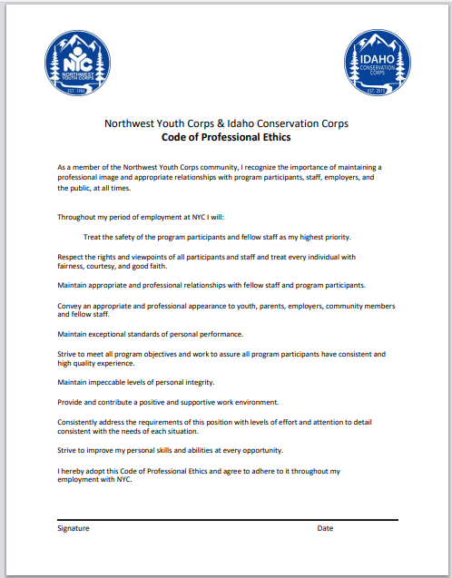
Code of Professional Ethics

Slide 21
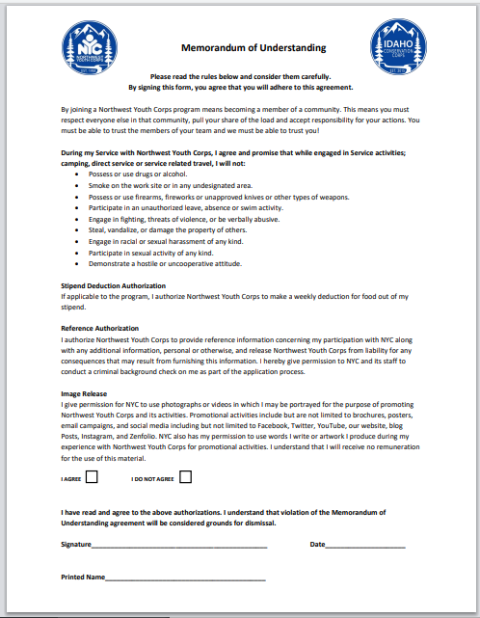
Memorandum of Understanding

Slide 22
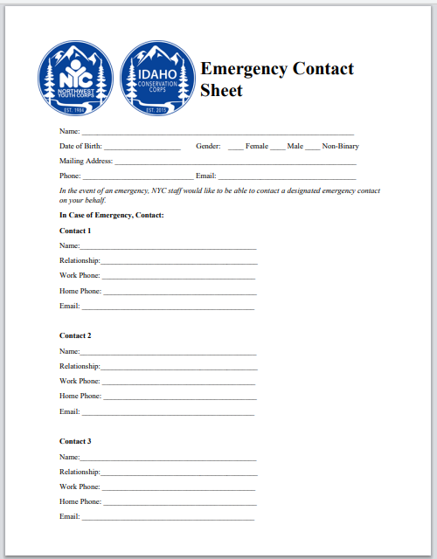
Emergency Contacts & Med History
Select gender
Enter information for contact 1, 2 and 3
Are you allergic to any medications?
Do you have any other allergies?
Do you have any dietary restrictions?
If yes, please provide all necessary information
If no, please leave blank or enter “N/A”

Slide 23
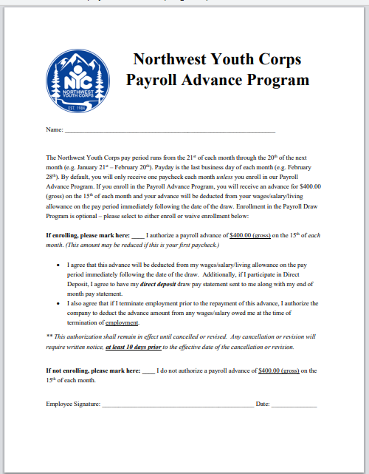
Payroll Advance Program

Slide 24
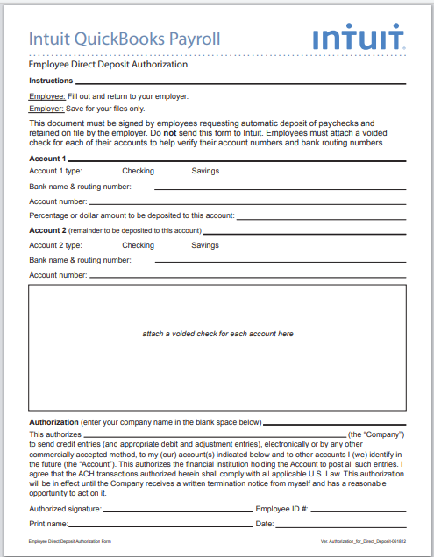
Direct Deposit Form
Select account type
Enter banking name & routing number, account number, percentage/dollar amount to be deposited (enter 100% for whole paycheck)
If applicable, add second account and employee #

Slide 25
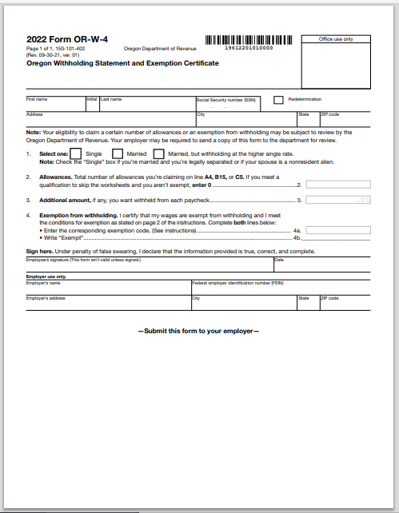
State W-4
Select withholding status
Enter number of allowances
If applicable, enter exemptions

Slide 26
Paperwork Check
Please review your documents to make sure you have:
Submitted ALL documents
All documents should have a status of “Accepted” or “Pending Admin Review”
If any documents have a status of “Rejected” or “Not Yet Received”, please complete and submit those forms now

Slide 27
Important Contact Information
Lev Kellendy, Conservation Internship Director
  levk@nwyouthcorps.org | 208-805-0325
  Office: 541-654-4706
Matthew Schlegel, Internship Program Coordinator
  matthews@idahocc.org | 208-625-8402
  Office: 208-593-7622
Abi Snow, Internship Program Coordinator
  abigails@nwyouthcorps.org |541-521-3139
  Office: 541-654-4704

Slide 28
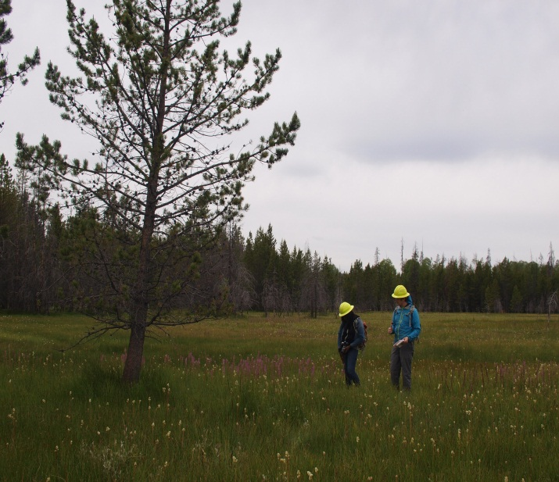
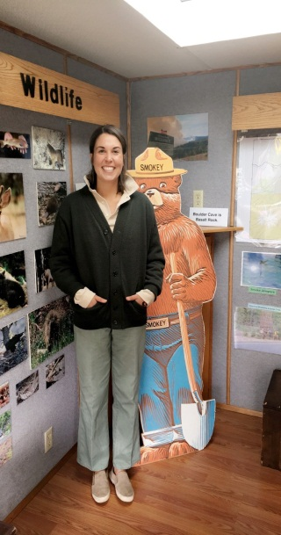
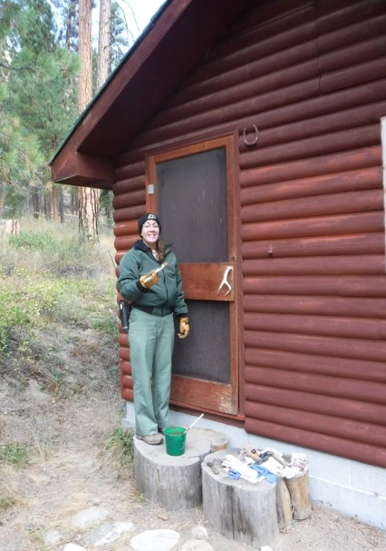
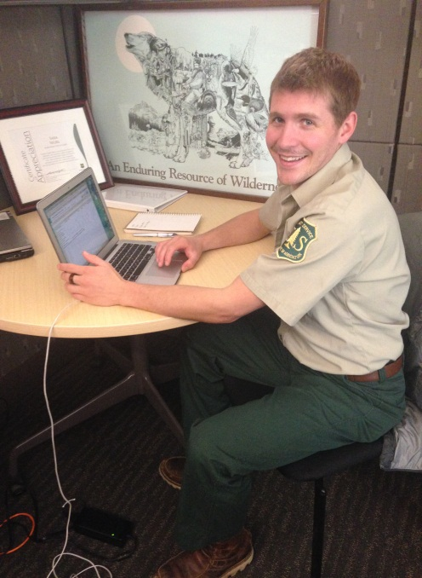
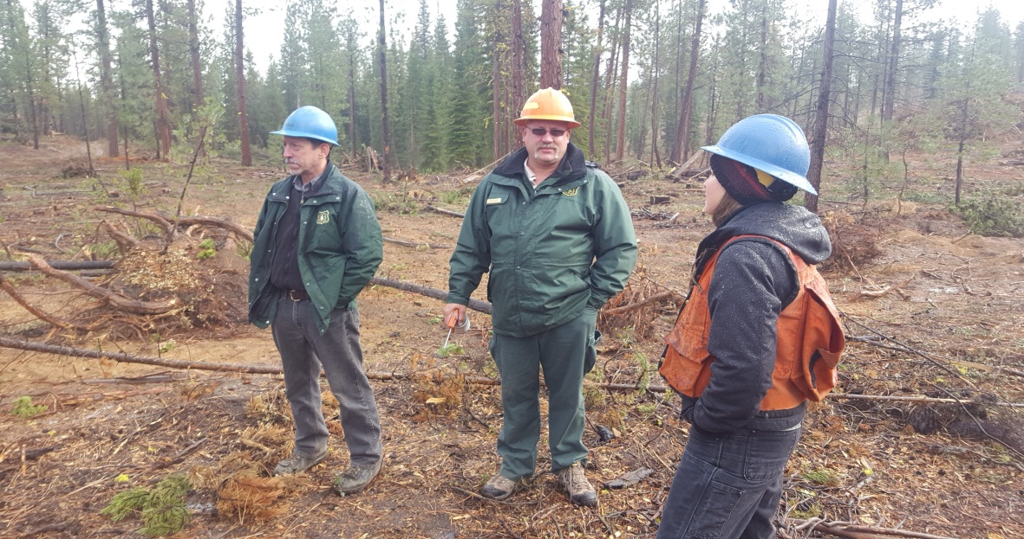
Thank you!

