Slide 1





AmeriCorps Conservation Internship Orientation

Slide 2

AmeriCorps Goals:
Getting Things Done
Strengthening Communities
Encouraging Responsibility
Expanding Opportunity
Created in 1993
  AmeriCorps VISTA started in 1965
National and Community Service Trust Act – Signed into Law by Bill Clinton
Supports over 2 million Americans in service each year.
AmeriCorps Is
Serve with AmeriCorps
AmeriCorps What’s at your Core?
Notes:
Change pictures to real people

Slide 3
AmeriCorps
AmeriCorps*VISTA
AmeriCorps*
State & National
AmeriCorps*NCCC
State
National
Oregon Volunteers
The Corps Network
Northwest Youth Corps
Idaho Conservation Corps

Slide 4


The Corps Network
130+ Corps Programs Nation Wide
Around 26,000 Corps Members Annually
Provides Partial Funding for our Programs
TCN Accounts for 20% of all AmeriCorps Members Nationally
Evolved through the Civilian Conservation Corps
  What TCN Does
  Improve & preserve public lands and national parks
  Provides energy conservation services
  Restore natural habitats and create urban parks and gardens
  Provides disaster preparation and recovery
  Renovates deteriorating housing
  Supports in-school and after school programs
We are the Doers - Strengthening America Through Service & Conservation

Slide 5


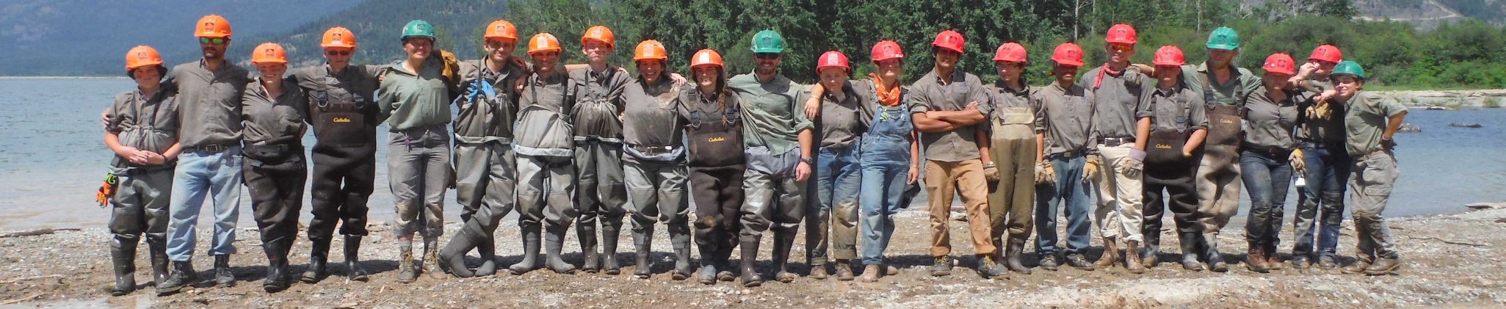
Northwest Youth Corps
Mission:
Northwest Youth Corps and Idaho Conservation Corps offer a challenging education and job-training experience that helps youth and young adults from diverse backgrounds develop the skills they need to lead full and productive lives.
History:
Created in 1984 (Founder Art Pope)
Modeled after the historic Civilian Conservation Corps of the 1930's

Slide 6

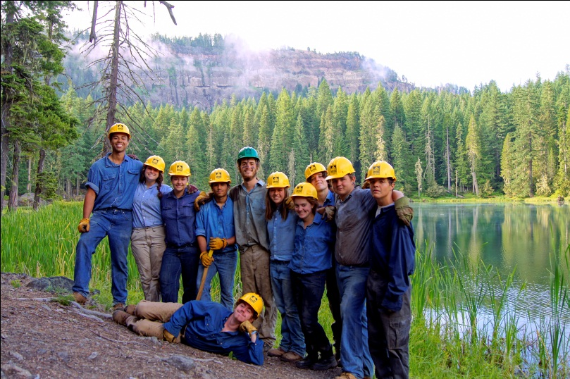

Northwest Youth Corps & Idaho Conservation Corps
Youth and Young Adult Programming
Serve 1,000 participants per year 19 – 26
Residential and non-residential offerings
Accredited curriculum
Internship Programming
USFS Resource Assistant Program (RAP)
Conservation Internship Program
AmeriCorps Internship Program
Core Values
Education
Leadership
Community
Empowerment
Challenge
Operating Sites:
Eugene, OR
Tacoma, WA
Boise, ID

Slide 7

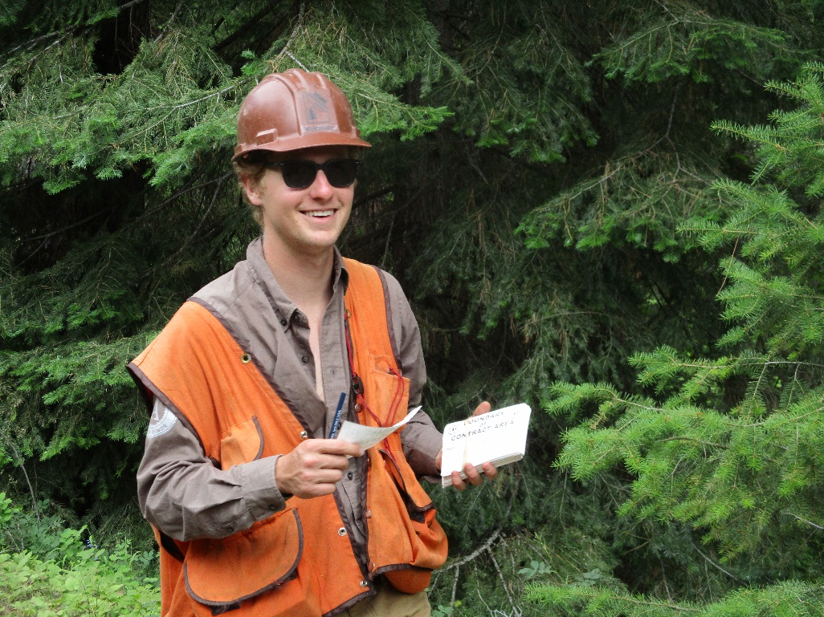
The Conservation Internship program is designed to provide hands-on training and experience to those interested in pursuing employment with land and water resource management agencies.
Terms are 3-10 months
Project types may include:
  Restoring and improving public lands and waters
  Invasive species inventory and treatment
  Trail maintenance and recreation infrastructure
  Community engagement
  Outdoor recreation
  Natural resource data collection
https://www.nwyouthcorps.org/internresources/

Slide 8
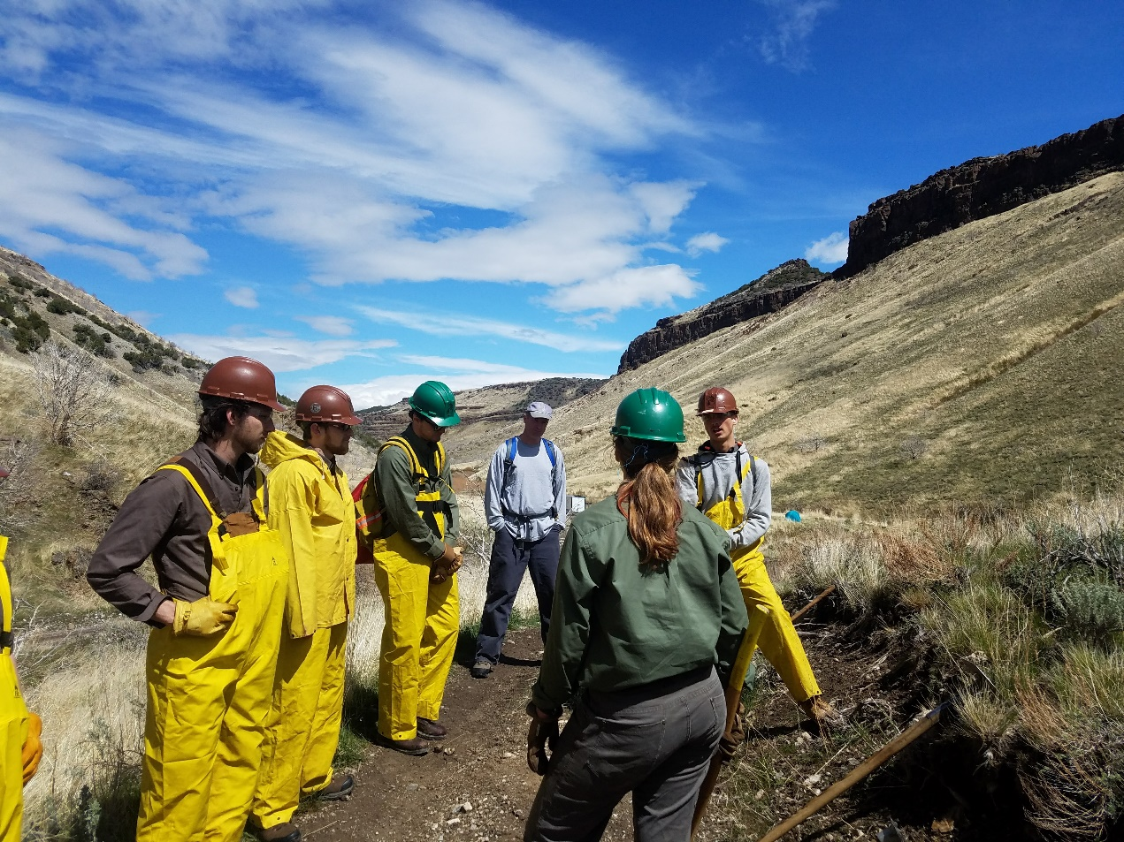
Support and Development
Mentorship and professional development
Mental and physical health
Mediation
Check-ins and site visits

Slide 9
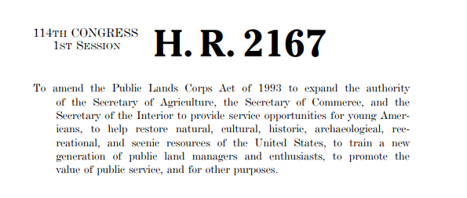
Public Lands Corps
Will you complete 640 hours of service on PLC-eligible projects with 120 hours of “physical lands improvement” work? Are you between 16-30 years old?
  If the answer to both of these is yes, you may be eligible for a non-competitive hiring certificate, which you can upload to your USAjobs.gov account!
  Ask your Program Officer for more information if you are interested!
Notes:
Discuss what PLC is, who may be eligible, and how to use it. Instruct interns to follow up afterwards if they want specific instructions.

Slide 10
Attendance Policy
Attendance is a mandatory requirement to successfully complete your AmeriCorps term​
  Punctual and regular attendance is an essential responsibility of each member at NYC.​​
Member's will be subject to disciplinary action if either of the following occurs:​
  Absences exceed more than 10% of their expected service hours​
  Absences prevent you from meeting the minimum term requirements

Slide 11
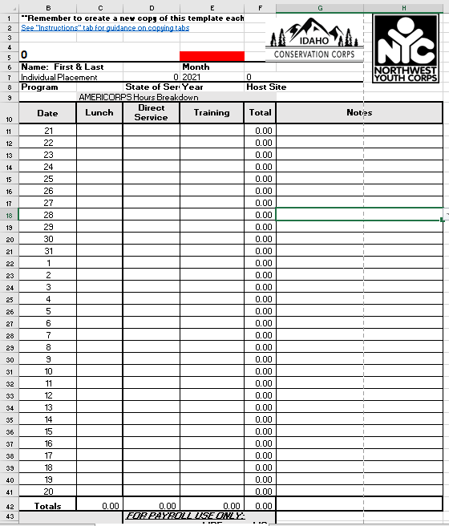
Timesheets and Reporting
Pay period:
21st of the month to the 20th of the following month.
  Example: February 21- March 20, 2024
Payday: Last business day of each month
Sign and Date your timesheet.
Have your supervisor approve your hours
Scan and send timesheets via e-mail to your coordinator around the 20th of each month (electronic placeholder).
Mail original to your coordinator

Slide 12
Payroll and Timesheets
About stipends
  40-hr workweek
  Leave time
    Please email site and NYC supervisors for leave requests
Digital placeholder timesheets (Due by 21st of each month)
IMPORTANT: Date your timesheets correctly
IMPORTANT: Wet-ink timesheets
No more than 20% of total working time should be training
Production Reporting/Timesheet Workbook
  Monthly Photo Upload
Pay Stubs: Intuit Payroll Services
  Emailed link that lasts for 10 days once received

Slide 13
Payroll
Paychecks are transmitted via direct deposit on the last business day of the month
  Please upload a voided check or other bank statement that includes the account and routing numbers for verification
Interns may request a payroll draw by completing a Draw Request Form. Draws cannot exceed $400.
Requests need to be made early in the week if not enrolled in Draw Program

Slide 14
Reimbursement Policy
Submit receipts to Airtable link
Must be pre-approved by supervisor (by email)
Must be an itemized receipt
Mileage reimbursement requirements
  Driver Record Check
  Driver License Upload
  Auto Insurance Card/Policy Upload
  Must pass a Driver Training Course

Slide 15
Workers Compensation
What should I do if I am injured during the scope of my work?
1. Immediately report the injury to your site supervisor
2. Contact Northwest Youth Corps
Lev Kellendy, Office: 541-654-4706
Matthew Schlegel, Office: 208-593-7622
Abi Snow, Office: 541-654-4704
3. Get medical treatment at Urgent Care or Emergency Room
4. Tell medical staff you sustained a work-related injury and are covered under Workers Comp
5. Request Return to Work Release from the treating physician
6. Complete State based Workers Compensation Form
7. Scan documents to jessicaj@nwyouthcorps.org

Slide 16
Uniform and Dress Code
You will receive:
Some notes:
Long-sleeve
Short-Sleeve
Trucker hat
Pin
AmeriCorps Prohibited Activities
Partner requirements
Ambassadorship

Slide 17
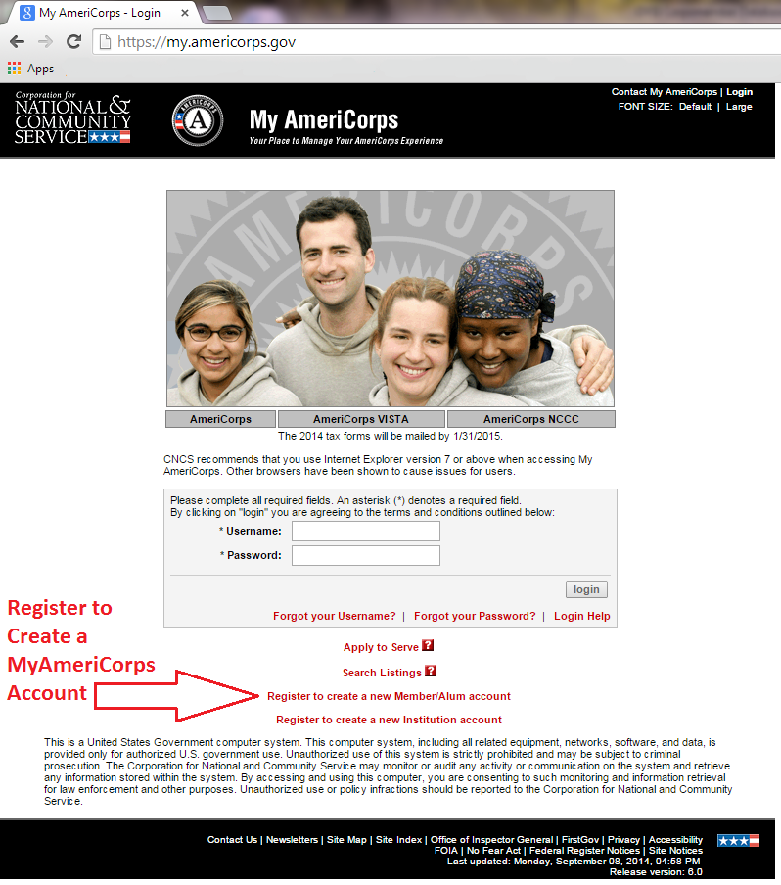
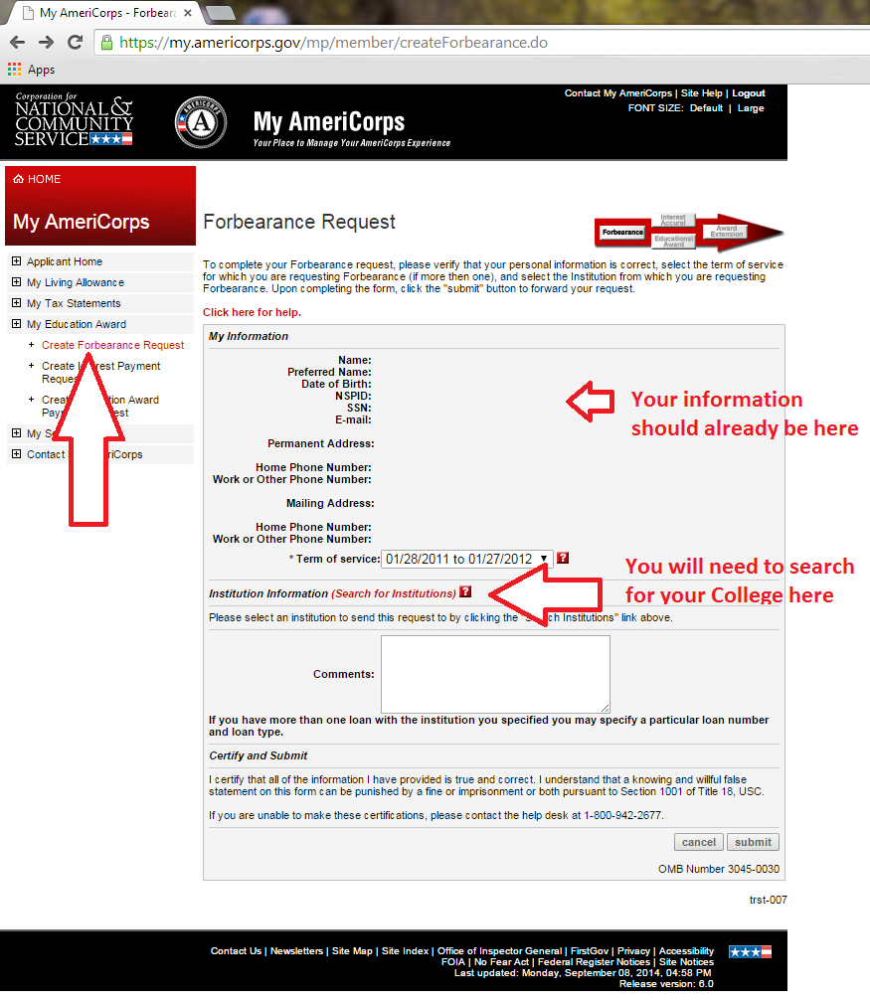
Loan Forbearance
https://my.americorps.gov

Slide 18

AmeriCorps Education Award
The amount of the award is:
Full Time – 1700hrs: $6,895
Half Time – 900hrs: $3,447.50
Reduced Half Time – 675hrs: $2,626.27
Quarter Time – 450hrs: $1,824.07
Minimum Time – 300hrs: $1,459.26
You may receive a maximum of the equivalent of 2 Full-time Awards
You have up to 7 years from the date you complete your service to use your award
The award is subject to income tax the year it is used

Slide 19
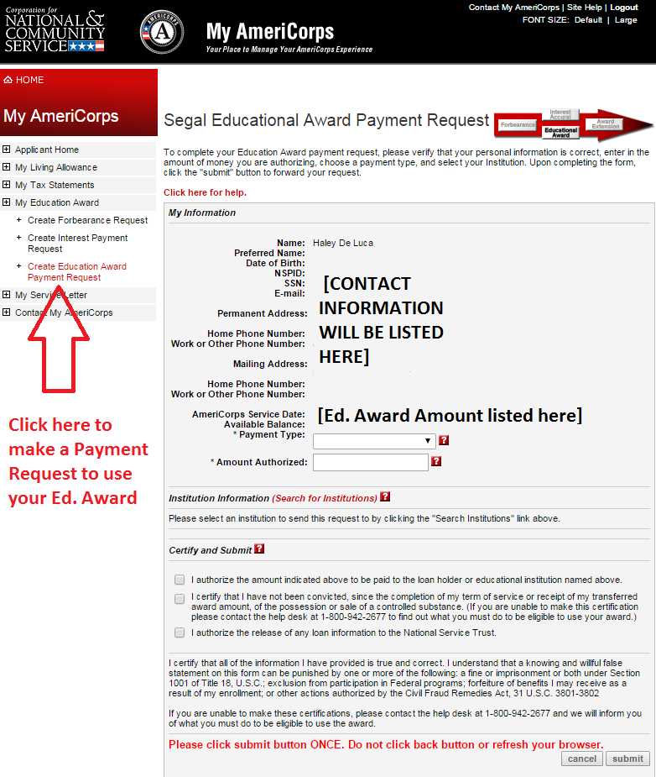
AmeriCorps Education Award
Online system
  Within 30 days, members can access their Ed Award Online at my.americorps.gov website.
  Full or partial payments can be made
    Members can watch their balances and monitor any activity all via the website.
  If your school or loan holder is not on the my.americorps.gov site, you can encourage them to join

Slide 20
Food Stamps
What You Need
AmeriCorps Letter
Position description
Please note: NYC does not guarantee that you will receive food stamps. We will supply you with the resources you will need to apply, but the determination of benefits is outside our control.

Slide 21
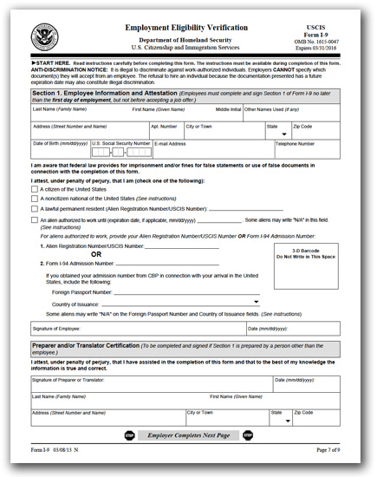
Paperwork
Hire Letter
I-9 (Need copies of Identifications – N/A’s)
W-4
Direct Deposit
Payroll Draw Program (If Applicable)
Acknowledge and release
Code of Ethics
Memorandum of Understanding
Emergency & Contact Information
Medical Information
AmeriCorps Paperwork
Scan all documents into an e-mail to: matthews@idahocc.org or abigails@nwyouthcorps.org
Send original paperwork:
NYC – Abi Snow, Northwest Youth Corps, 2621 Augusta Street Eugene, OR 97403
ICC – Matthew Schlegel, Northwest Youth Corps, 6051 W Corporal Lane Boise, ID 83704

Slide 22
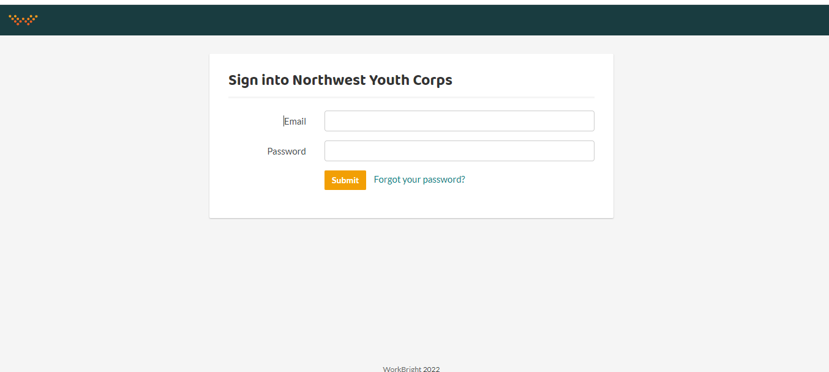
WorkBright Onboarding
Go to https://nwycorps.workbright.com/
If you forgot your password, please click “Forgot your password?” for a quick email to reset it

Slide 23
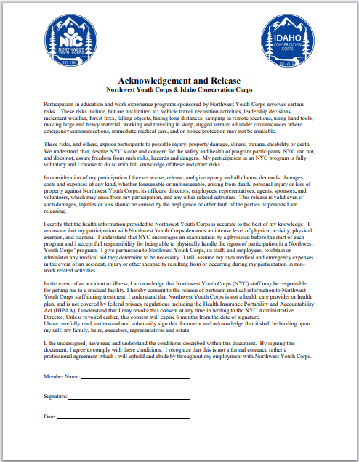
Acknowledgement and Release

Slide 24
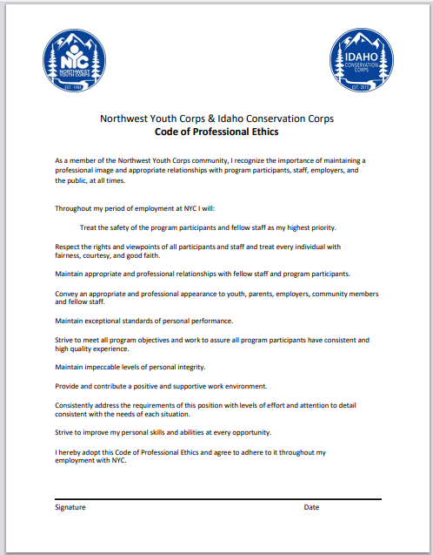
Code of Professional Ethics

Slide 25
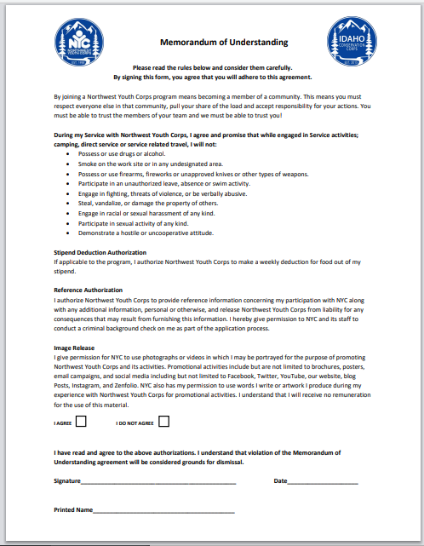
Memorandum of Understanding

Slide 26
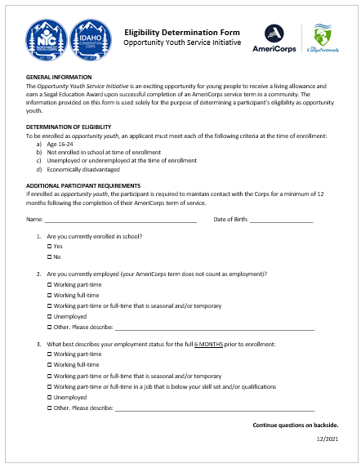
Opportunity Youth Eligibility Form
Demographic data collection form
Self- disclosed answers so answer to the best of your knowledge
Are you currently enrolled in school?
Are you currently employed?
What best describes your employment status for the last 6 months?

Slide 27
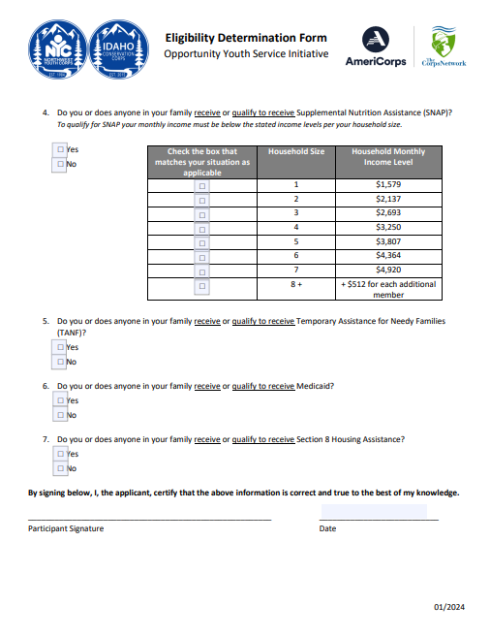
Opportunity Youth Eligibility Form Pg. 2
Do you or does anyone in your family receive or qualify to receive Supplemental Nutrition Assistance (SNAP)?
Select household size
Do you or does anyone in your family receive or qualify to receive TANF, Medicaid, or Section 8 Housing Assistance?

Slide 28
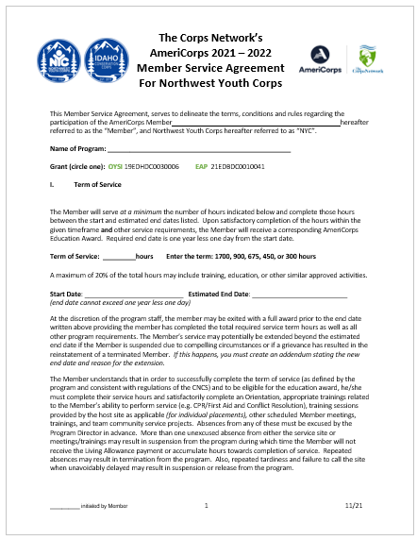
Member Service Agreement

Slide 29
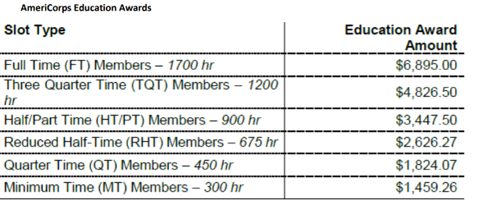
Term of Service & Benefits
To successfully complete a service term, members must:
Complete required number of hours
Satisfactorily complete assignments, tasks, or projects
Attend training sessions and meetings
Meet all other criteria as communicated by NYC
Section I, II

Slide 30
Sections III, IV, V
Minimum Qualifications
Position Description & Responsibilities
Available for total hours of program
Successfully complete criminal history checks to being accepted
Verification of identity and social security number
Adherence to rules and regulations
Maintain compliant timesheets
Don’t participate in Prohibited Activities as outlined in section VI
Further duties as described in the attached position description
Host Sites: Members placed at host sites cannot be assigned to certain activities
Sections III, IV, V

Slide 31
Sections VI, VII
A Member is Prohibited from:
A Member is Expected To:
Engage in illegal activities under local, state, or federal law;
Engaging in religious or political organizations while serving hours and/or in NYC uniform
Engage in activities that pose a significant safety risk to others;
Unauthorized tardiness;
Unauthorized absences;
Repeated use of inappropriate language at job site;
Failure to wear appropriate clothing to service sites;
Stealing or lying;
Engaging in activity that may physically or emotionally damage other members of the program or of the community;
Possess/using/consuming/manufacturing/distributing/dispensing/being under the influence of: illegal drugs, a controlled substance, and/or alcoholic beverages during term of service;
Failing to notify program of any criminal arrest or conviction during your term of service.
Demonstrate mutual respect towards others;
Follow Directions;
Direct concerns, problems and suggestions to the appropriate program official;
Attend all AC meetings and trainings;
Adhere to the rules & regulations;
Maintain timesheets and keep track of hours;
Anticipate working full time (40-45 hours a week)
Section VI, VII

Slide 32
AmeriCorps Prohibited Activities
Individuals may exercise their rights as private citizens and may participate in the able activities on their initiative, on non-AmeriCorps time, and using non-Corporation funds. The AmeriCorps logo should not be worn while doing so.
legislation
1. Attempting to influence ____________.
2. Organizing or engaging in protests,__________, boycotts or strikes.
3. Assisting, promoting or deterring ________________.
4. Impairing _________________ for services or collective bargaining.
5. Engaging in partisan political activities or other activities designed to influence the outcome of an election to any public office
6. Engaging in _________________________ that are likely to include advocacy for or against political parties,
political platforms, political candidates, proposed legislation or elected officials.
7. Engaging in religious instruction; ___________________________; providing instruction as part of a program
that includes mandatory religious instruction or worship; maintaining facilities primarily or inherently
devoted to religious instruction or worship; or engaging in any form of ______________________.
8. Providing __________________ : a for-profit entity; a labor union; a partisan political organization; an
organization engaged in religious activities describe in the above listing #6, unless grant funds are not used to
support religious activities; or a nonprofit entity that fails to comply with the restrictions contained in section
501c3 of US Code Title 26.
9. Voter registration drives.
10. Clerical work, research, or fund raising activities unless such activities are incidental to the member’s direct service activities
11. Abortion Services
12. Other activities the CNCS and NYC determine to be prohibited upon notice to the site.
petitions
union organizing
existing contracts
partisan political activities
conducting worship services
religious proselytization
a direct benefit to
Section VII, VIII

Slide 33
Sections IX
AmeriCorps Specifics
Non-Duplication and
Non-Displacement
Members are not traditional volunteers because they receive a living allowance and an education award.
Members are not employees.
Because members are not employees the living allowance is a stipend, not earned wage.
As a result, at no point during or immediately following service may a member file for unemployment benefits.
Non-Duplication – CNCS assistance may not be used to duplicate an activity that is already available in the locality of a program.
Non-Displacement – An employer may not displace an employee or position.
Sections IX

Slide 34
Disciplinary Guidelines for Improper Conduct
Discipline Policy
Disciplinary Actions
First Offense - Verbal Warning
Second Offense - Written Warning
Third Offense - Suspension
Fourth Offense - Discharge
A. The Corps may temporarily suspend or impose a fine for minor disciplinary reasons.
B. Members may be released if they repeatedly or periodically continue to demonstrate inappropriate behavior in a patter of misconduct.
C. Members will be either suspended or released for cause in accordance to Section VIII “Drug Free Workplace” of the AC Handbook.
Section X

Slide 35
Release from Participation
Does NOT include
Compelling Personal Circumstances
To enroll in school;
Because of dissatisfaction with the program.
If member leaves early, in order to be re-hired, they must receive a satisfactory performance review.
Otherwise they cannot serve in AmeriCorps again.
Disability, serious illness, or death of a Member’s family member if this makes completing the term unreasonably difficult or impossible
Military service obligations
Conditions attributable to the program or otherwise unforeseeable and beyond the member’s control, such as:
  a natural disaster, a strike, relocation of a spouse, or the non-renewal or premature closing of a project or program, that make completing a term unreasonably difficult or impossible.
Acceptance by a participant of an opportunity to make the transition from welfare to work.
Release For Cause
Failing to complete required number of service hours in the time allotted
Violating the Program’s discipline
The participant has the primary responsibility for demonstrating that compelling personal circumstances prevent the participant from completing the term of service.
Documentation must be provided.
Sections X

Slide 36
Release for Compelling Circumstance
Under “Compelling Personal Circumstances” NYC with input from the member can do one of the following:
Suspend Member’s Term of Service
This suspension results in the member completing his/her Term of Service upon release of Suspension.
The member’s End Date is extended once reinstated, though only for as long as the member was suspended.
Exit the Member
If the member is exited prior to their completion, NYC can choose to award the member a pro-rated Ed Award which corresponds monetarily to the number of hours served.
Member must serve at least 15% of their total service hours to be eligible for a pro-rated award.
Section X

Slide 37
Grievance Procedure
If you have an issue during your term, please follow these steps:
  1. If it is with a fellow intern, address the issue with the individual
  2. Talk with your Supervisor
  3. Talk with your NYC Program Coordinator
  If the issue remains, NYC has HR personnel you can reach out to.
Section XI

Slide 38
Non-Discrimination Policy
NYC does not discriminate in program admission based on race, color, sexual orientation, military discharge, sex, national origin, age, disability, or any other characteristic
NYC and our sponsors will make reasonable accommodations and encourage you to bring up any questions or concerns regarding issues related to discrimination or harassment (including sexual harassment).
  Sexual Harassment is defined as:
    “unwelcome sexual advances, requests for sexual favors, and other verbal or physical conduct of a sexual nature ... when ... submission to or rejection of such conduct is used as the basis for employment decisions ... or such conduct has the purpose or effect of ... creating an intimidating, hostile or offensive working environment.”
Discrimination or harassment of any kind will not be tolerated.
Anyone found to be engaging in any type of unlawful or harassing discrimination will be subject to disciplinary action, up to and including dismissal from the program.
Mandatory Reporter Policy
Section XII

Slide 39
Sections XIII, VII
Drug-Free Workplace
Civil Rights and
Non-Harassment
AmeriCorps and NYC has zero tolerance for the harassment of any individual or group of individuals for any reason.
AmeriCorps and NYC has zero tolerance for violation of the drug-free workplace.
Sections XIII, VII

Slide 40
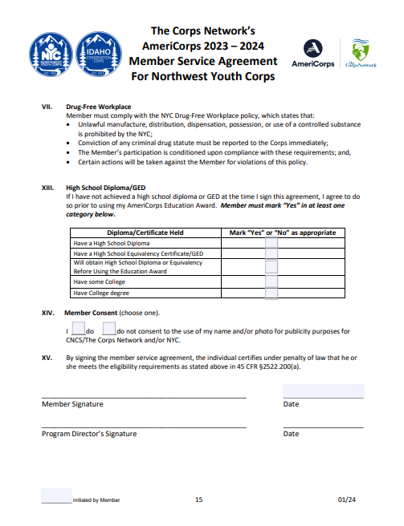
Sections XIII, XIV
Sections XIII, XIV

Slide 41
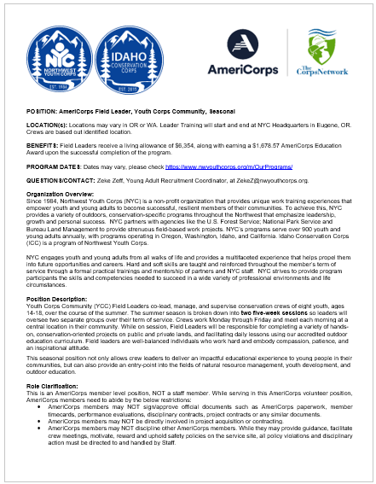
Position Description
General outline of crew member expectations, possible certifications (depending on projects), and requirements

Slide 42
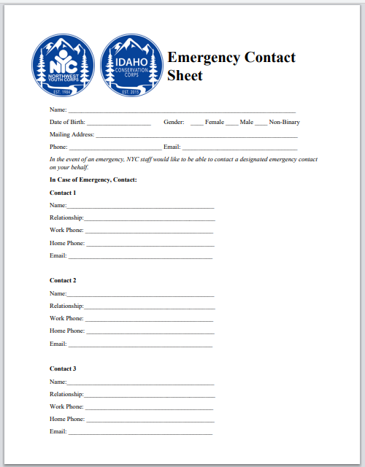
Emergency Contacts & Med History
Select gender
Enter information for contact 1, 2 and 3
Are you allergic to any medications?
Do you have any other allergies?
Do you have any dietary restrictions?
If yes, please provide all necessary information
If no, please leave blank or enter “N/A”

Slide 43
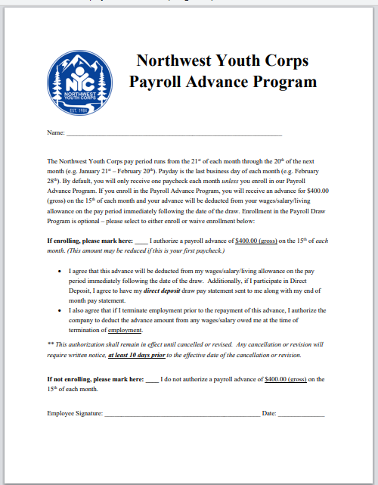
Payroll Advance Program

Slide 44
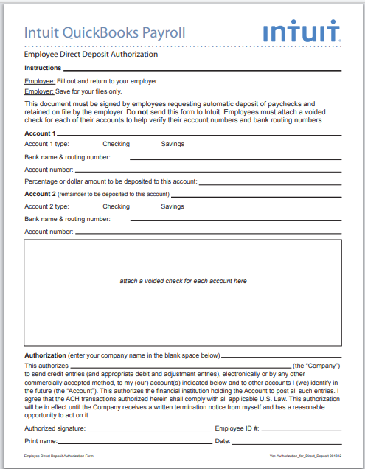
Direct Deposit Form
Select account type
Enter banking name & routing number, account number, percentage/dollar amount to be deposited (enter 100% for whole paycheck)
If applicable, add second account and employee #

Slide 45
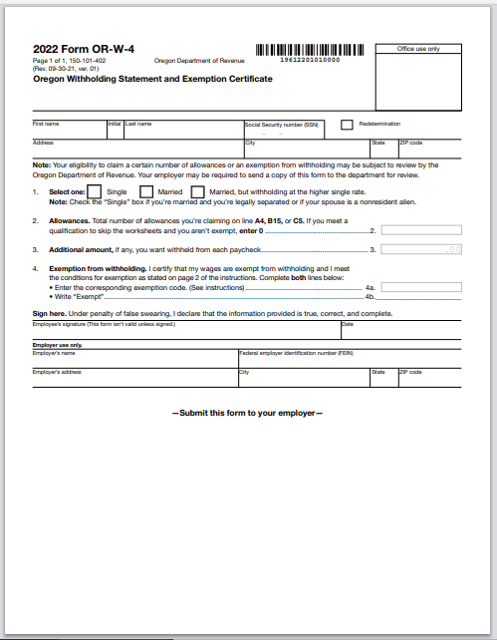
State W-4
Select withholding status
Enter number of allowances
If applicable, enter exemptions

Slide 46
Paperwork Check
Please review your documents to make sure you have:
Submitted ALL documents
All documents should have a status of “Accepted” or “Pending Admin Review”
If any documents have a status of “Rejected” or “Not Yet Received”, please complete and submit those forms now

Slide 47

AmeriCorps Pledge
The AmeriCorps Pledge
I will get things done for America
to make our people safer,
smarter, and healthier.
I will bring Americans together
to strengthen our communities.
Faced with apathy,
I will take action.
Faced with conflict,
I will seek common ground.
Faced with adversity,
I will persevere.
I will carry this commitment
with me this year and beyond.
I am an AmeriCorps member,
and I am going to get things done.

Slide 48
Important Contact Information
Lev Kellendy, Conservation Internship Director
  levk@nwyouthcorps.org | 208-805-0325
  Office: 541-654-4706
Matthew Schlegel, Internship Program Coordinator
  matthews@idahocc.org | 208-625-8402
  Office: 208-593-7622
Abi Snow, Internship Program Coordinator
  abigails@nwyouthcorps.org |541-521-3139
  Office: 541-654-4704

