Slide 1




Conservation Internship Orientation

Slide 2


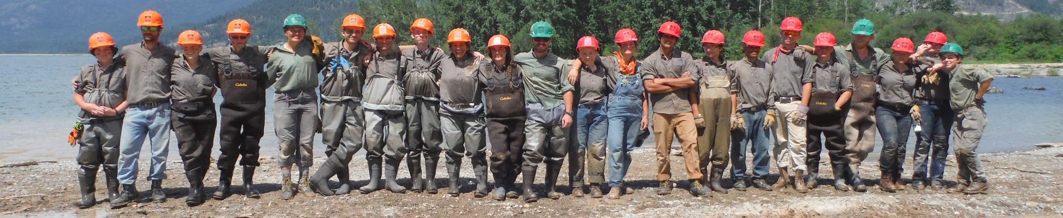
Northwest Youth Corps
Mission:
Northwest Youth Corps and Idaho Conservation Corps offer a challenging education and job-training experience that helps youth and young adults from diverse backgrounds develop the skills they need to lead full and productive lives.
History:
Created in 1984 (Founder Art Pope)
Modeled after the historic Civilian Conservation Corps of the 1930's
Notes:
Civilian Conservation Corps was one of the first programs in Roosevelt’s New Deal and was aimed towards young, unemployed, and unmarried men. NYC and ICC have modeled many things after the CCC, but also improved upon many – it’s not just young, unemployed, unmarried men who can do this kind of work anymore!

Slide 3



Northwest Youth Corps & Idaho Conservation Corps
Youth and Young Adult Programming
Serve 1,000 participants per year 19 – 26
Residential and non-residential offerings
Accredited curriculum
Internship Programming
USFS Resource Assistant Program (RAP)
Conservation Internship Program
AmeriCorps Internship Program
Core Values
Education
Leadership
Community
Empowerment
Challenge
Operating Sites:
Eugene, OR
Tacoma, WA
Boise, ID

Slide 4

The Conservation Internship program is designed to provide hands-on training and experience to those interested in pursuing employment with land and water resource management agencies.
Terms are 3-10 months
Project types may include:
Restoring and improving public lands and waters
Invasive species inventory and treatment
Trail maintenance and recreation infrastructure
Community engagement
Outdoor recreation
Natural resource data collection
https://www.nwyouthcorps.org/internresources/

Slide 5
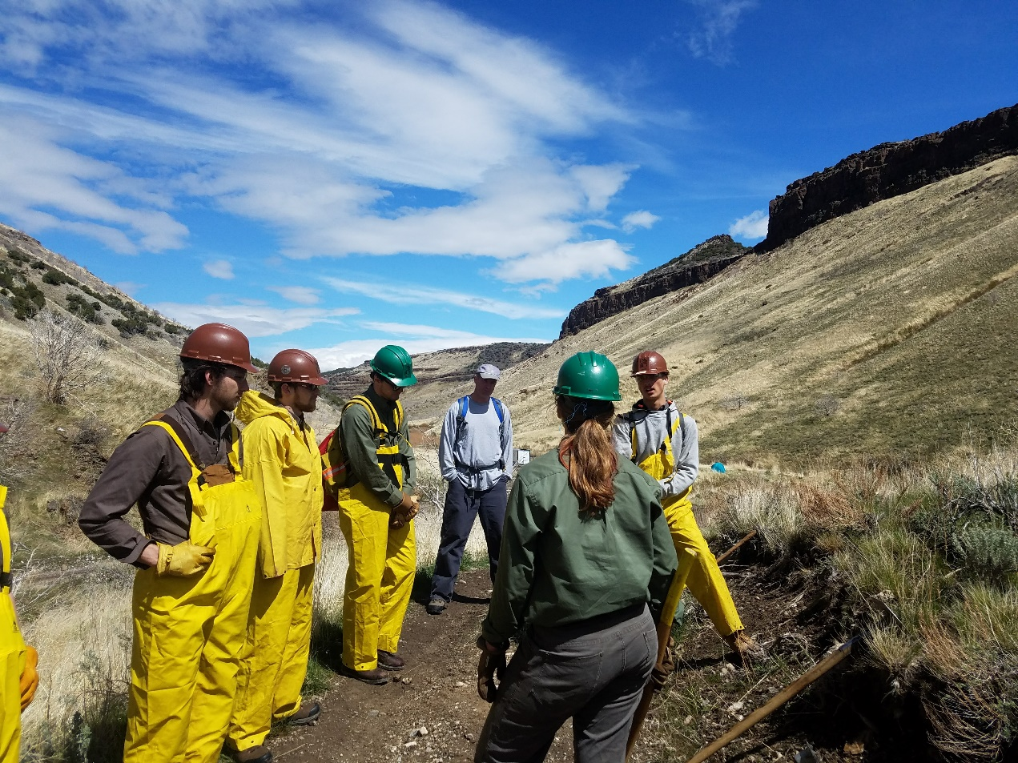
Support and Development
Mentorship and professional development
Mental and physical health
Mediation
Check-ins and site visits

Slide 6
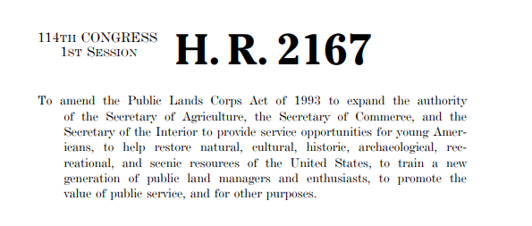
Public Lands Corps
Will you complete 640 hours of service on PLC-eligible projects with 120 hours of “physical lands improvement” work? Are you between 16-30 years old?
If the answer to both of these is yes, you may be eligible for a non-competitive hiring certificate, which you can upload to your USAjobs.gov account!
Ask your Program Officer for more information if you are interested!
Notes:
Discuss what PLC is, who may be eligible, and how to use it. Instruct interns to follow up afterwards if they want specific instructions.

Slide 7
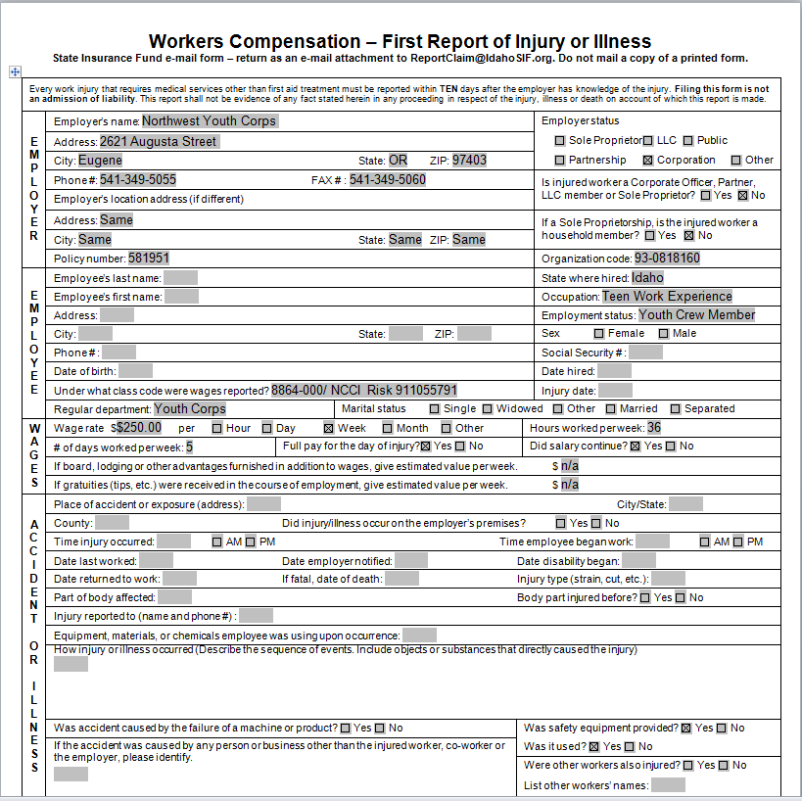
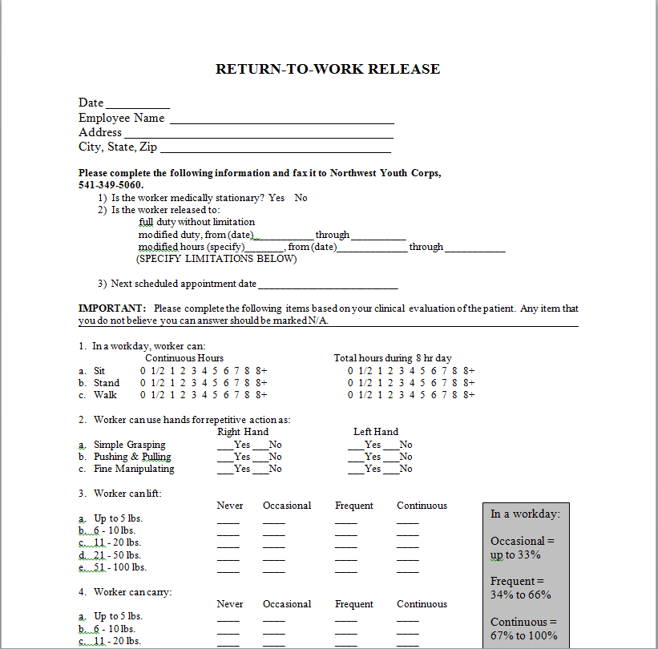
Workers Compensation What should I do if I am injured during the scope of my work?
1. Immediately report the injury to your site supervisor
2. Contact Northwest Youth Corps
Lev Kellendy, Office: 541-654-4706
Matthew Schlegel, Office: 208-593-7622
Abi Snow, Office: 541-654-4704
3. Get medical treatment at Urgent Care or Emergency Room
4. Tell medical staff you sustained a work related injury and are covered under Workers Comp
5. Request Return to Work Release from the treating physician
6. Complete State based Workers Compensation Form
7. Email documents to jessicaj@nwyouthcorps.org

Slide 8
Payroll and Timesheets
About stipends
40-hr workweek
Leave time
Please email site and NYC supervisors for leave requests
Digital placeholder timesheets (Due by 21st of each month)
IMPORTANT: Date your timesheets correctly
IMPORTANT: Wet-ink timesheets
No more than 20% of total working time should be training
Production Reporting/Timesheet Workbook
Monthly Photo Upload
Pay Stubs: Intuit Payroll Services
Emailed link that lasts for 10 days once received

Slide 9
Payroll
Paychecks are transmitted via direct deposit on the last business day of the month
Please upload a voided check or other bank statement that includes the account and routing numbers for verification
Interns may request a payroll draw by completing a Draw Request Form. Draws cannot exceed $400.
Requests need to be made early in the week if not enrolled in Draw Program

Slide 10
Timesheet Guidelines:
All regular hours for Interns are reported in the ‘Direct Service’ column.
Use the ‘Notes’ column to document atypical occurrences, such as reasons for taking leave. Do not use the notes column to describe the details of your daily work (i.e. “Led Interpretive Hike”).
Placeholder Timesheets: It is required to submit a timesheet with wet signatures and dates in ink. However, due to the delay in mailing a signed timesheet to the Northwest Youth Corps office you are also required to submit an electronic ‘Placeholder Timesheet’ via email to matthews@idahocc.org or abigails@nwyouthcorps.org
Your Placeholder Timesheet is due no later than the 20th of each month. Date all timesheets as the 20th of the current month.
‘Wet ink’ timesheets should be mailed to:
NYC – Abi Snow, Northwest Youth Corps, 2621 Augusta Street Eugene, OR 97403
ICC – Matthew Schlegel, Northwest Youth Corps, 6051 W Corporal Lane Boise, ID 83704

Slide 11
Reimbursement Policy
Submit receipts to Airtable link
Must be pre-approved by supervisor (by email)
Must be an itemized receipt
Mileage reimbursement requirements
Driver Record Check
Driver License Upload
Auto Insurance Card/Policy Upload
Must pass a Driver Training Course

Slide 12
Attendance Policy
Attendance is a mandatory requirement ​
Punctual and regular attendance is an essential responsibility of each member at NYC.​​
Member's will be subject to disciplinary action if either of the following occurs:​
Unexcused absences exceed more than 10% of their expected service hours​
Absences prevent you from meeting the minimum term requirements
An Excused absence is:
An absence that has been pre-approved by your NYC point of contact and your Site Supervisor (Example: Federal Holiday).
If you need a sick day, please let NYC know ASAP.
Absences 5 days or longer may result in a suspension until you return. (Example: Sick time, extended leave.)

Slide 13
Ambassadorship and Uniform
You will receive:
Long-sleeve
Short-sleeve
Trucker hat
Pin
Some notes:
Partner requirements
Ambassadorship

Slide 14
Non-Discrimination Policy
NYC does not discriminate in program admission based on race, color, sexual orientation, military discharge, sex, national origin, age, disability, or any other characteristic
NYC and our sponsors will make reasonable accommodations and encourage you to bring up any questions or concerns regarding issues related to discrimination or harassment (including sexual harassment).
Sexual Harassment is defined as:
“unwelcome sexual advances, requests for sexual favors, and other verbal or physical conduct of a sexual nature ... when ... submission to or rejection of such conduct is used as the basis for employment decisions ... or such conduct has the purpose or effect of ... creating an intimidating, hostile or offensive working environment.”
Discrimination or harassment of any kind will not be tolerated.
Anyone found to be engaging in any type of unlawful or harassing discrimination will be subject to disciplinary action, up to and including dismissal from the program.
Mandatory Reporter Policy

Slide 15
Grievance Procedure
If you have an issue during your term, please follow these steps:
1. If it is with a fellow intern, address the issue with the individual
2. Talk with your Supervisor
3. Talk with your NYC Program Coordinator
If the issue remains, NYC has HR personnel you can reach out to.
Section XI

Slide 16
Paperwork
I-9 (N/A’s)
W-4
Peach Tree Direct Deposit
Acknowledgement and Release
Code of Professional Ethics
Memorandum of Understanding
Emergency & Contact Information (Make Copy for Partner)
Medical Information

Slide 17
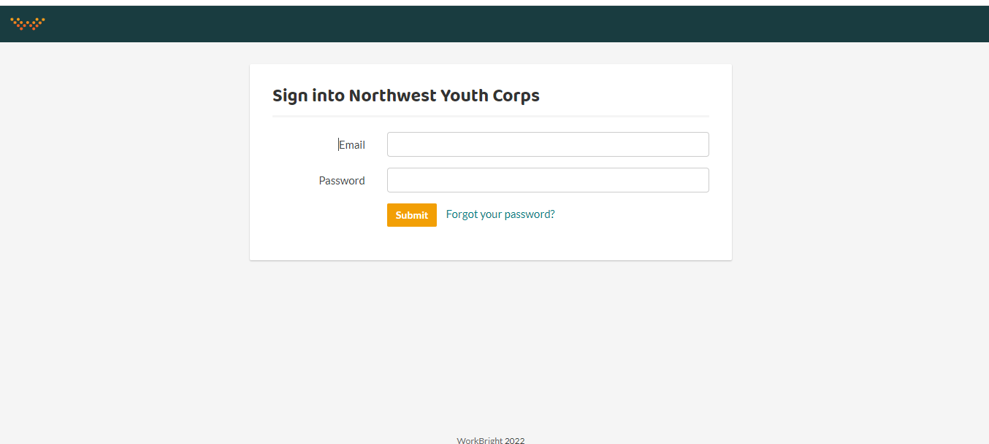
WorkBright Onboarding
Go to https://nwycorps.workbright.com/
If you forgot your password, please click “Forgot your password?” for a quick email to reset it

Slide 18
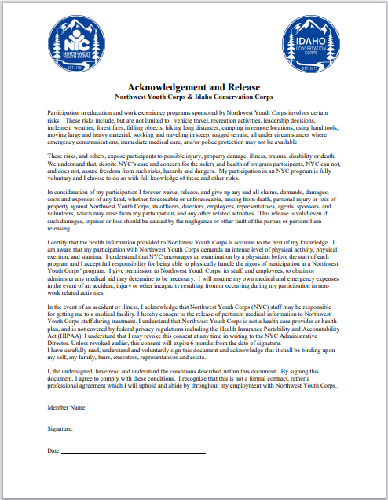
Acknowledgement and Release

Slide 19
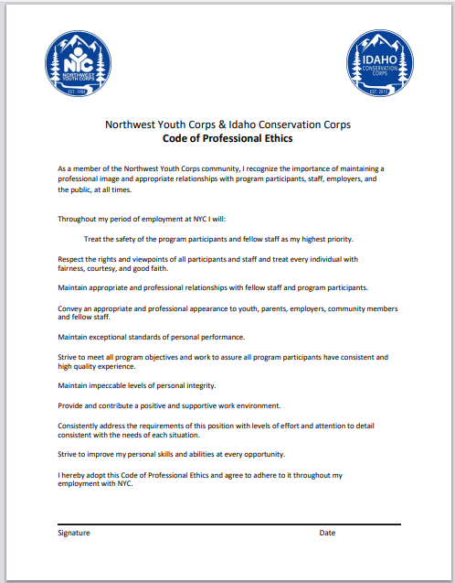
Code of Professional Ethics

Slide 20
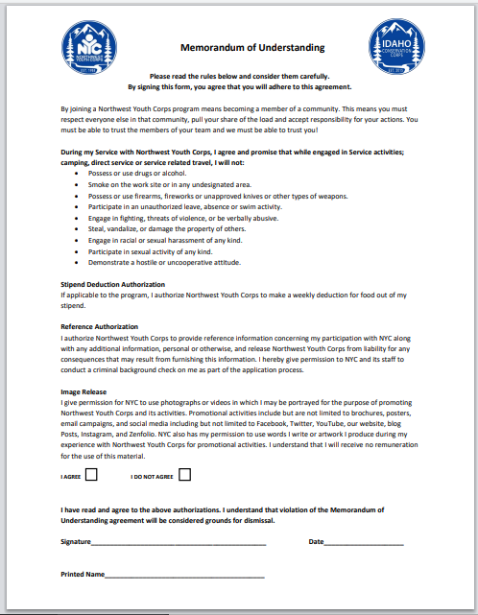
Memorandum of Understanding

Slide 21
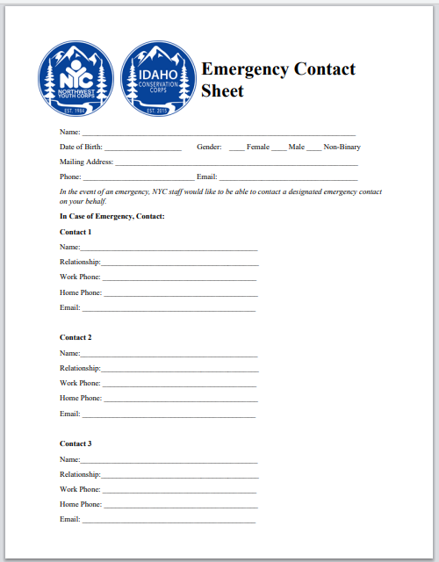
Emergency Contacts & Med History
Select gender
Enter information for contact 1, 2 and 3
Are you allergic to any medications?
Do you have any other allergies?
Do you have any dietary restrictions?
If yes, please provide all necessary information
If no, please leave blank or enter “N/A”

Slide 22
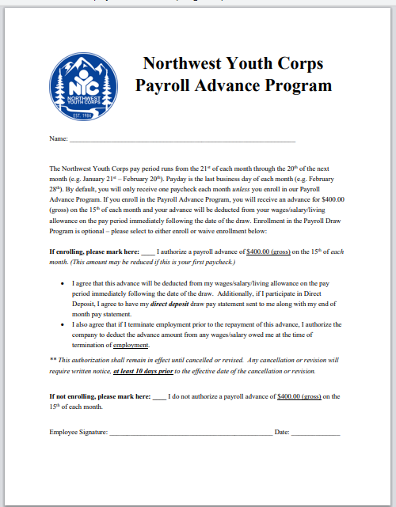
Payroll Advance Program

Slide 23
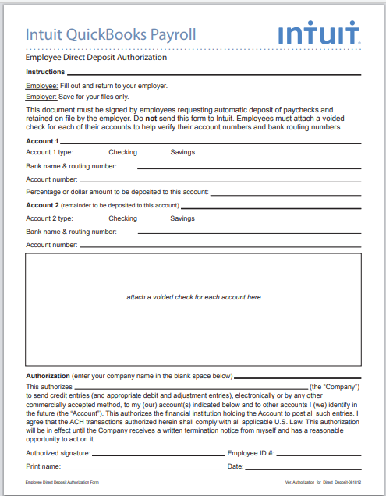
Direct Deposit Form
Select account type
Enter banking name & routing number, account number, percentage/dollar amount to be deposited (enter 100% for whole paycheck)
If applicable, add second account and employee #

Slide 24
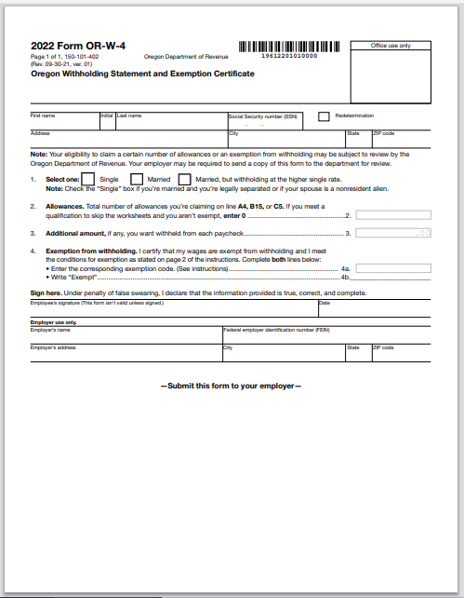
State W-4
Select withholding status
Enter number of allowances
If applicable, enter exemptions

Slide 25
Paperwork Check
Please review your documents to make sure you have:
Submitted ALL documents
All documents should have a status of “Accepted” or “Pending Admin Review”
If any documents have a status of “Rejected” or “Not Yet Received”, please complete and submit those forms now

Slide 26
Connect with us and stay in contact!
Lev Kellendy, Conservation Internship Director
levk@nwyouthcorps.org | 208-805-0325
Office: 541-654-4706
Matthew Schlegel, Internship Program Coordinator
matthews@idahocc.org | 208-625-8402
Office: 208-593-7622
Abi Snow, Internship Program Coordinator
abigails@nwyouthcorps.org |541-521-3139
Office: 541-654-4704

